Slide 1
St Andrew’s Day .
30th November
Made by: Tina Bakić, 8.a
Presented by: Tina Bakić, Lucija Glasnović and Petra Gudac, 8.a

Slide 2
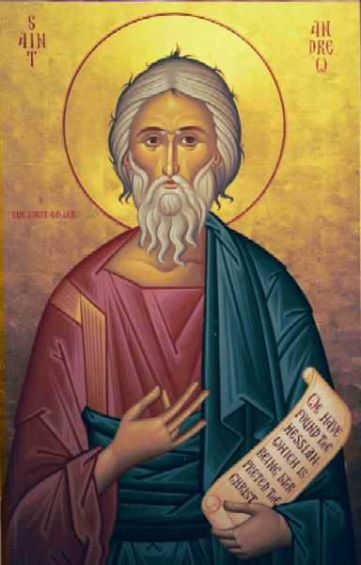
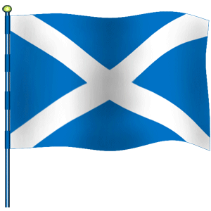
Generally about St Andrew’s Day
it is an official national holiday in Scotland
St Andrew is the patron saint of Scotland
the Flag of Scotland is also known as Saint Andrew's Cross or the Saltire
Saint Andrew’s Cross
St Andrew

Slide 3
Generally about St Andrew’s Day
St Andrew was the first disciple of Jesus Christ and according to the legend, he was crucified on an x-shaped cross at Patras in Achea (Greece)
the icon (the cross) appeared first on seals of the Guardians of Scotland (heads of Scotland)

Slide 4
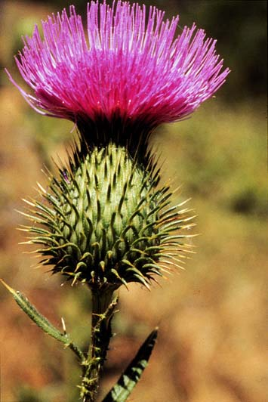
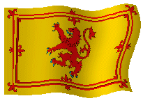
Generally about St Andrew’s Day
the Scottish Royal Banner of Arms is Lion Rampant
it is flown only when British King or Queen are present
national colour – blue
national emblem – the plant thistle
Lion Rampant
thistle

Slide 5
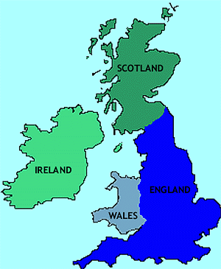
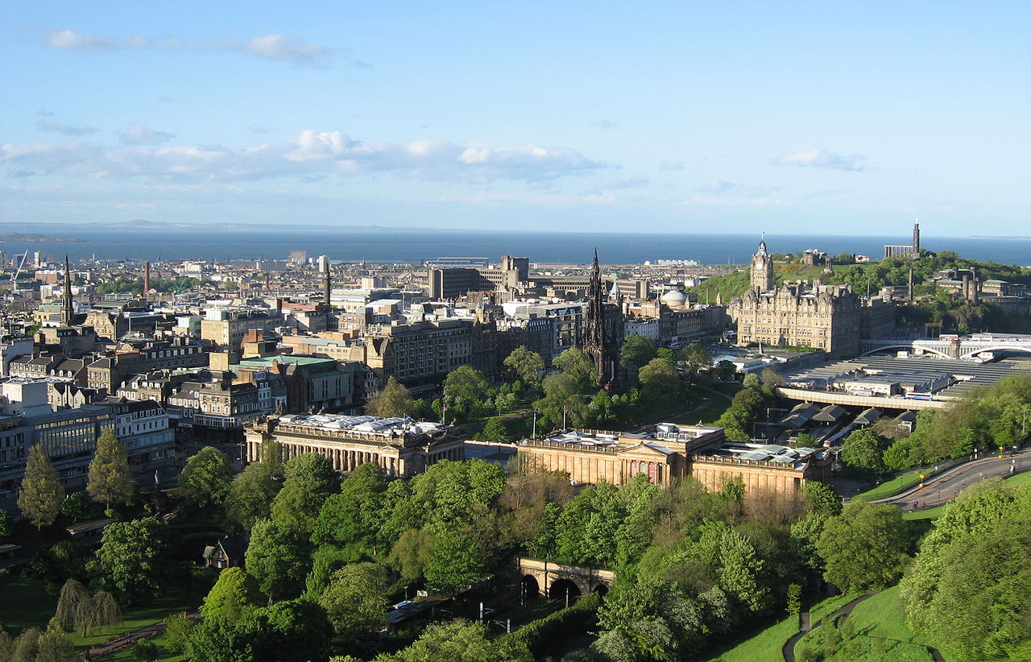
Scotland
located on the northern part of the island of Great Britain
the capital is Edinburgh, Scotland's 2nd largest city
the largest city is Glasgow
Edinburgh

Slide 6
Scotland
it is comprised of 790 islands which include the Northern Islands and the Hebrides
population of Scotland is over 5 million people
Scottish Islands

Slide 7
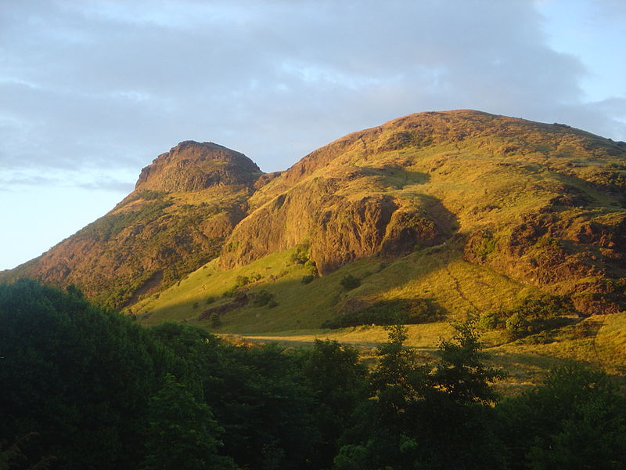
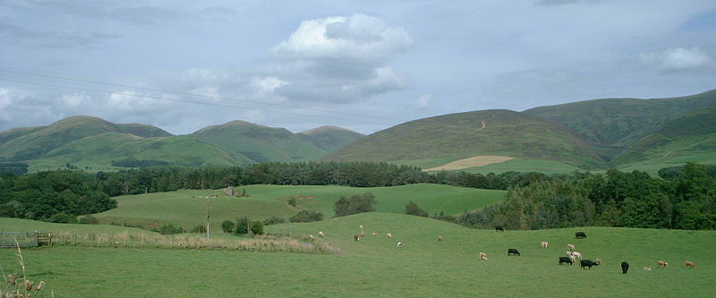
Scotland
Scotland is divided into three main regions
the Highlands
Midland Valley
Southern Uplands

Slide 8
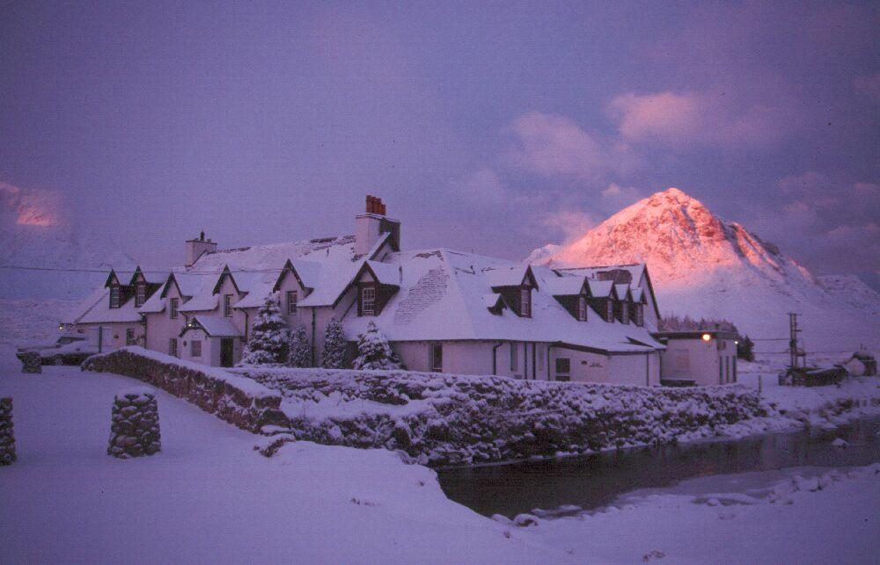
Scotland
climate is oceanic and temperate; summers are wet and cold
the official language is English, but Gaelic is also spoken there
Winter in Scotland
http://www.youtube.com/watch?v=YCzUSJo5zqI

Slide 9
Top 10 Scotland's Landmarks
Edinburgh Castle
-magnificent example of Scotland's architecture

Slide 10
Top 10 Scotland's Landmarks
Eilean Donan
-a small island with a medieval castle

Slide 11
Top 10 Scotland's Landmarks
Ben Nevis
-the British Isle's highest summit

Slide 12
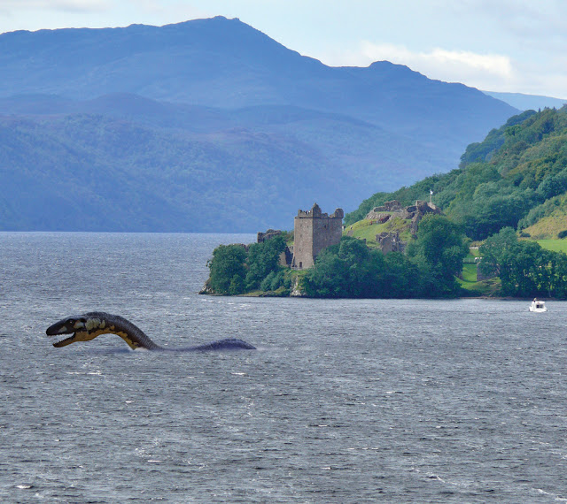
Top 10 Scotland's Landmarks
Loch Ness
-one of the most famous lakes in the world
-there's a legend of a sea monster Nessie, that
supposedly lives there

Slide 13
Top 10 Scotland's Landmarks
Luskentyre Beach

Slide 14
Top 10 Scotland's Landmarks
Stirling Castle
-one of the most spectacular castles in Scotland

Slide 15
Top 10 Scotland's Landmarks
Skara Brae
-one of the best preserved Stone Age villages

Slide 16
Top 10 Scotland's Landmarks
Cuillin Hills
-beautiful hills made of two different formations

Slide 17
Top 10 Scotland's Landmarks
Melrose Abbey
-founded in 1136 by monks, it is one of the most
historically significant architectural structures in
Scotland

Slide 18
Top 10 Scotland's Landmarks
Broch of Mousa
-in the Shetland Islands, a fortification or a
defensive tower, built around 100 BC

Slide 19
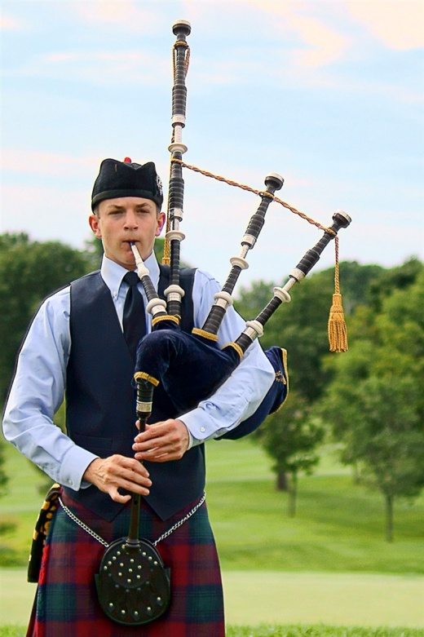
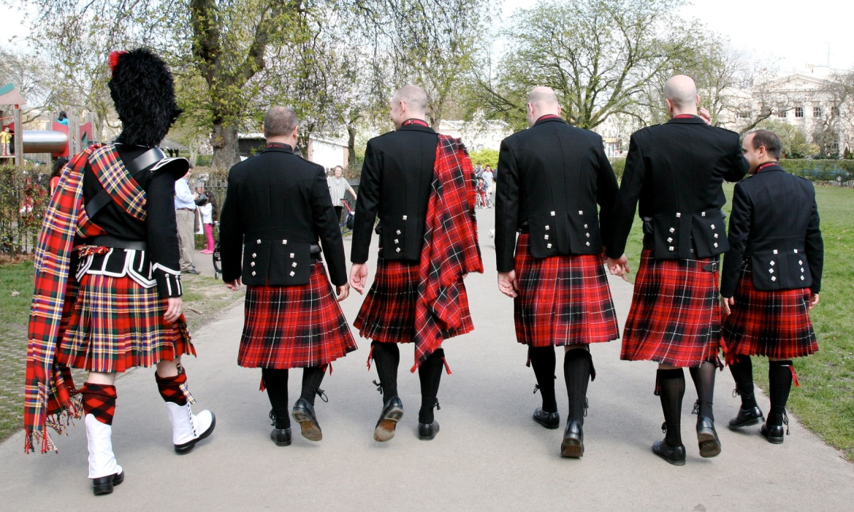
Bagpipes
Kilts
national instrument
http://www.youtube.com/watch?v=aPiqWzHiPmQ
traditional dress of men and boys in the Scottish Highlands in 16th century
it's made of woollen cloth in a tartan pattern

Slide 20
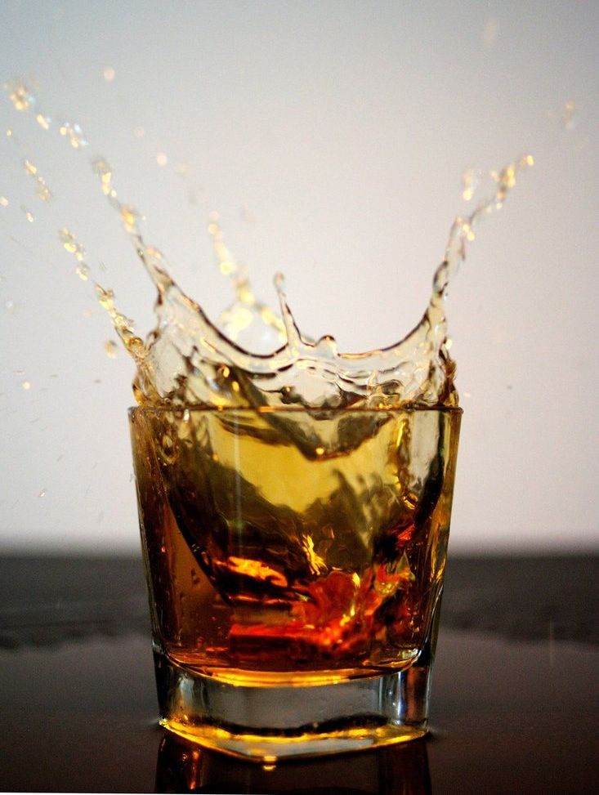
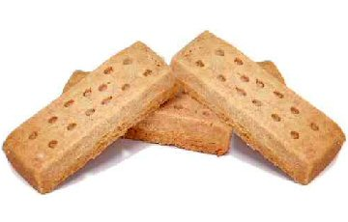
Traditional food
haggis – a pudding made of sheep's heart, lungs and liver, wrapped in a sheep's stomach
shortbread – a type of biscuit made of sugar, butter and flour
whiskey

Slide 21
Did you know?
That typical Sottish surnames have prefixes “Mac” or “Mc” in surnames such as McCall, MacCarthy, MacDonald
The Scottish form of “John” is “Ian”
A nickname for a Scottish person is Jock, but mind you, if the person who is using the nickname is not a friend, the nickname can sound rather insulting

Slide 22
Stereotypes
The Scots have a reputation for being careful with money
There are numerous jokes about Scots and their alleged thriftiness

Slide 23
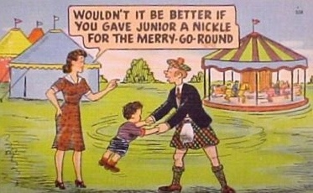
A Scotsman in London is having trouble phoning his sister from a telephone box. So he calls the operator who asks in a plummy voice: ‘Is there money in the box? ‘Naw, it’s just me,’ he replies.

Slide 24
Traditional song
Auld Lang Syne
It was written by Robert Burns in 1788
It’s traditionally used to celebrate the start of the New Year at the stroke of midnight
http://www.youtube.com/watch?v=acxnmaVTlZA

Slide 25
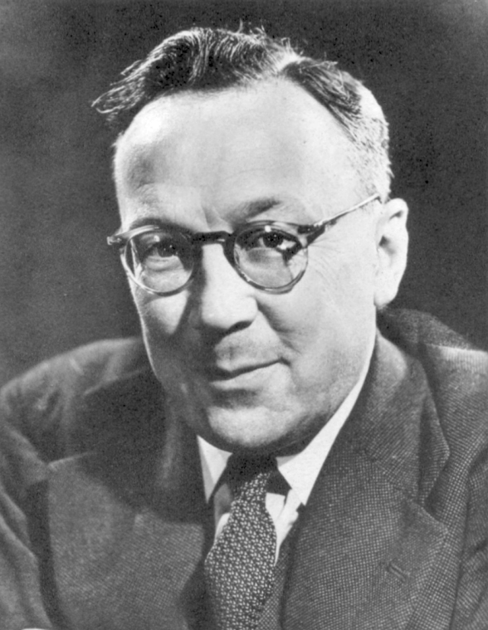
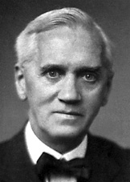
Great minds of Scotland
Sir Robert Watson-Wat (the inventor of radar)
Lord Kevin (famous physicist, a unit measurement for temperature was named after him)
Alexander Flemming (contributed to the discovery of penicillin)

Slide 26
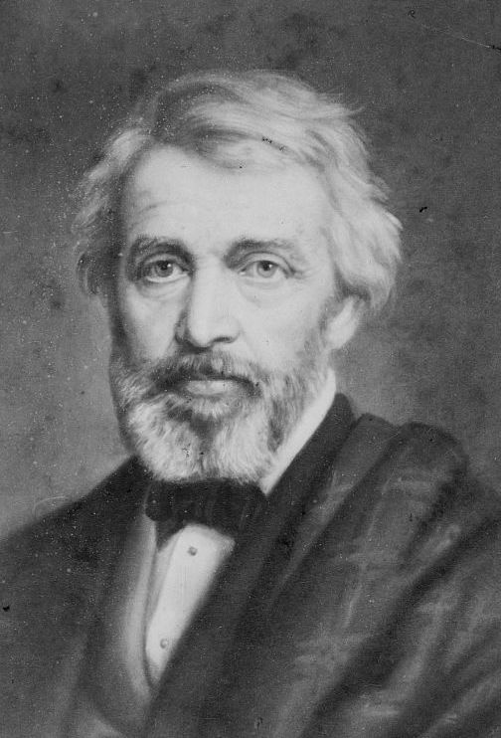
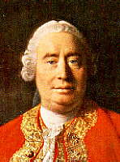
Great minds of Scotland
famous philosophers:
Adam Smith
David Hume
Thomas Carlyle

Slide 27
Scottish holidays
The St Andrew's Day
people have a day-off, celebrations including musical entertainment and ceilidh dancing (folk dancing)
Ceilidh

Slide 28
Scottish holidays
Hogmany
the last day of the year; it is famous for the practice of first-footing
first footing starts immediately after midnight on the New Year's Day
it involves being the first person to cross the treshold of a friend's or neighbour's house and it often involves the giving of symbolic gifts such as salt, coal, shortbread, whisky and black bun (a rich fruit cake) – they are supposed to bring luck to the householder
traditionally, tall dark men are preferred as the first-foot
Hogmany is also marked by fireball swinging
fireball swinging

Slide 29
Scottish holidays
Burns Supper
a celebration of the life and poetry of the famous Scottish poet Robert Burns (25th January)
Robert Burns

Slide 30
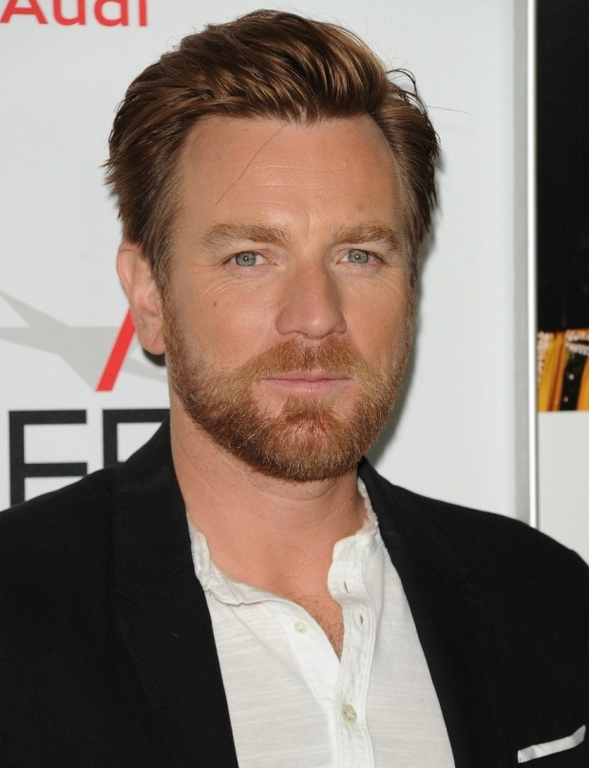
Famous Scots
Sean Connery
Ewan McGregor
Tild Swinton

Slide 31
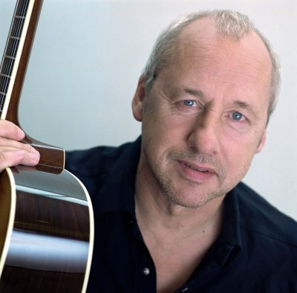
Famous Scots
Ian Anderson
Mark Knopfler
Gerard Butler

Slide 32
Famous Scots
Annie Lennox
Rod Stewart

Slide 33
Film industry
the movie that celebrated Scotland and the Scots around the world is definitely Mel Gibson's Braveheart which portrays William Wallace, a 13th century Scottish warrior who leads the Scots in their fight for independance against England

Slide 34
QUIZ
When do we celebrate St Andrew’s Day?
We celebrate it on 30th November.

Slide 35
QUIZ
Who is St Andrew?
St Andrew is the patron saint of
Scotland.

Slide 36
QUIZ
What is the national color of Scotland?
The national color of Scotland is blue.

Slide 37
QUIZ
What is the capital of Scotland?
The capital of Scotland is Edinburgh.

Slide 38
QUIZ
What is the official language?
The official language is English.

Slide 39
QUIZ
What is the name of Loch Ness monster?
The name of Loch Ness monster is Nessie.

Slide 40
QUIZ
What is the national instrument?
Bagpipes are the national instrument of Scotland.

Slide 41
QUIZ
Who wrote Auld Lang Syne, Scottish traditional song?
Robert Burns wrote it.

Slide 42
QUIZ
Name at least one famous Scot.
Sean Connery,Tild Swinton,Ewan
McGregor,Gerard Butler,Ian Anderson,
Mark Knopfler,Annie Lennox,Rod Stewart

Slide 43
QUIZ
Who starred in Braveheart?
Mel Gibson starred in Braveheart.

