Slide 1
Sport places and equipment
Vocabulary

Slide 2
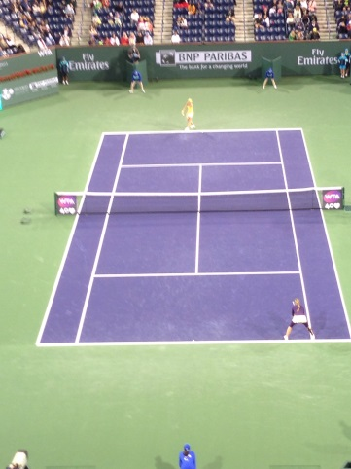
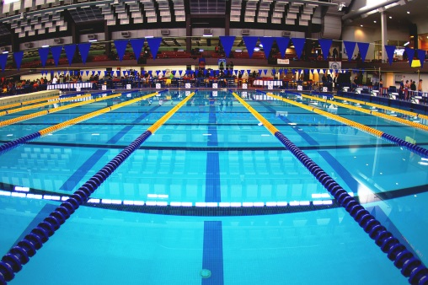
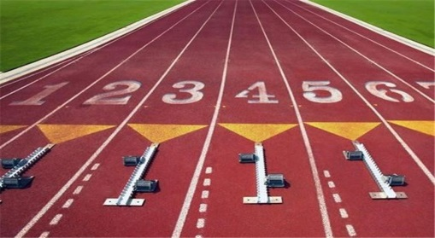
Match the places to the words.
a track
a rink
a court
a pool

Slide 3
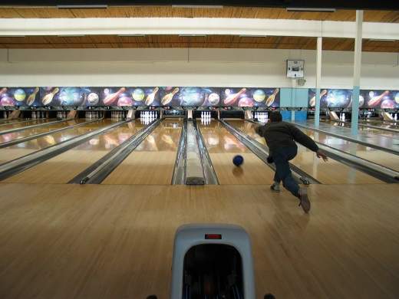
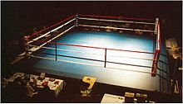
a pitch
a course
an alley
a ring

Slide 4
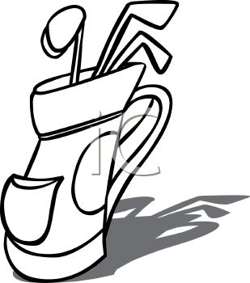
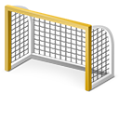
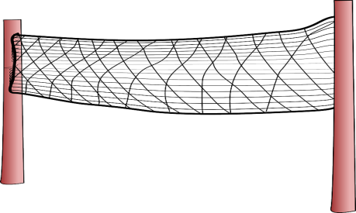
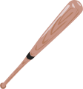
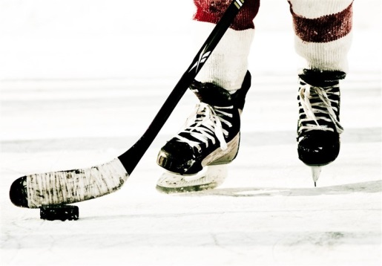
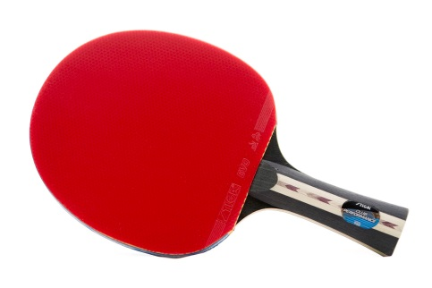
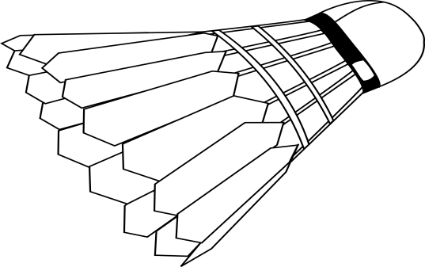
Label the pictures
a goal
a net
a racket
clubs
a bat
a stick and a puck
a shuttlecock

Slide 5
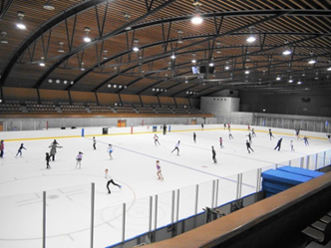
Match the sports to the places
swimming
athletics, motor racing
tennis, badminton, basketball, volleyball
ice hockey, skating
a pool
a track
a court
a pool
a court
a track
a rink
a rink

Slide 6
football, hockey, rugby
bowling
golf
boxing, wrestling
a pitch
a course
an alley
a pitch
a course
an alley
a ring
a ring

