Slide 1
Murder at the theatre
VOCABULARY

Slide 2
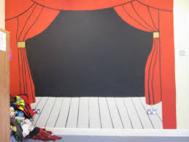
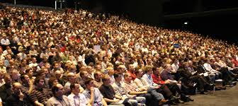
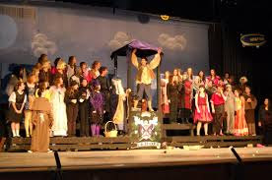
an area in a theatre on which actors perform
a piece of material that hangs across a window.
a group of people who watch or listen to a play
the actors in a film, a play or a show
a stage /steɪdʒ/
a curtain /ˈkɜːtən/
audience /ˈɔːdiəns/
cast /kɑːst/

Slide 3
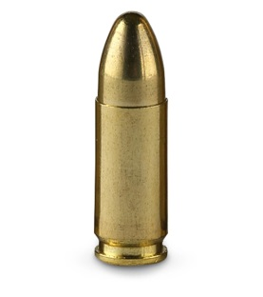
a bullet /ˈbʊlɪt/
a blank bullet
blackmail /ˈblækmeɪl/
threaten /ˈθretən/
a small metal object that is shot from a gun
a false bullet
getting money from people by threatening them
to tell someone that you will kill or hurt them

Slide 4
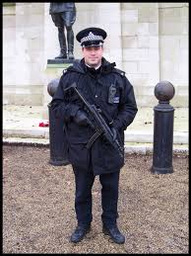
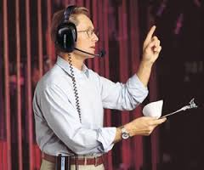
a constable /ˈkʌnstəbl̩/
a stage manager
a British police officer of the lowest rank
a person who is responsible for the equipment of the stage

