Slide 1
Bullying
Vocabulary

Slide 2
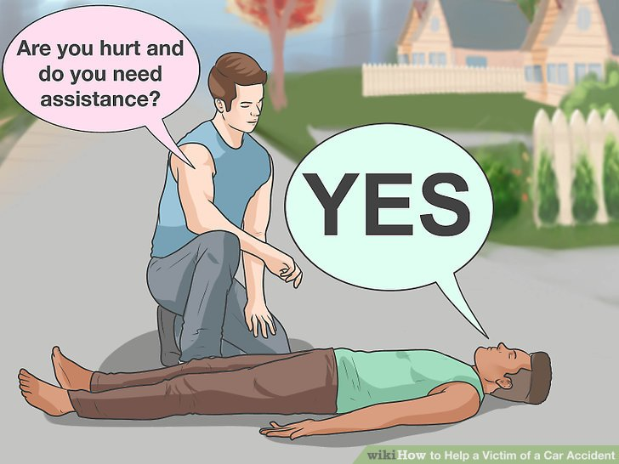
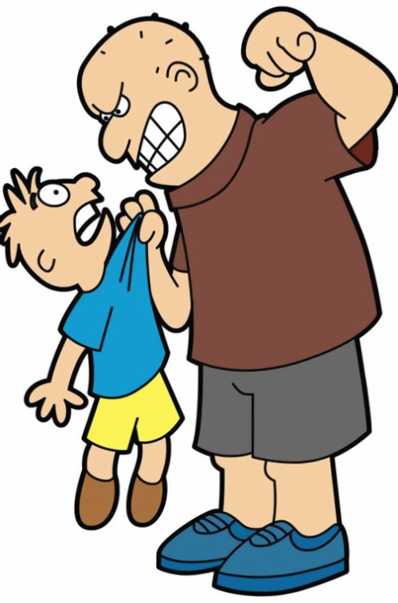
Toby was a typical victim of bullying.
victim /ˈvɪktɪm/ a harmed person
There were three boys who were real bullies.
bully /ˈbʊli/ a person who uses strength to harm others, (zlostavljač)

Slide 3
Their leader said he needed some new trainers.
leader /ˈliːdə/ the person who leads a group
I tried to grab them back.
grab /ɡrab/ grasp or seize suddenly (zgrabiti)
The boys pushed me against the hedge.
hedge /hɛdʒ/ a fence formed by bushes

Slide 4
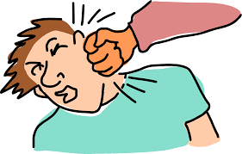
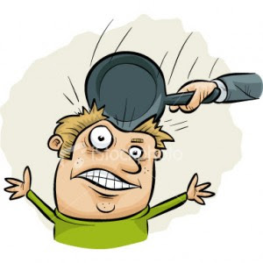
They punched and kicked me.
punch /pʌntʃ/ hit with a fist (udariti šakom)
kick /kɪk/ hit with a foot
(udariti nogom)
I didn’t want to be beaten up again.
beat up – kicked and punched repeatedly –(prebiti)

Slide 5
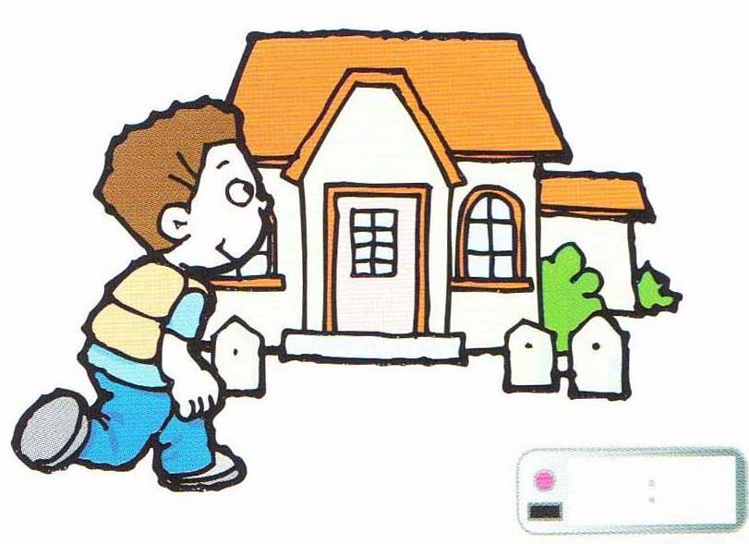
They even reached me at home.
reach /riːtʃ/ arrive at
We’ll see you tomorrow at break time.
break /breɪk/ a pause in work
The two bullies were expelled from school.
expel /ɪkˈspɛl/ force to leave school

Slide 6
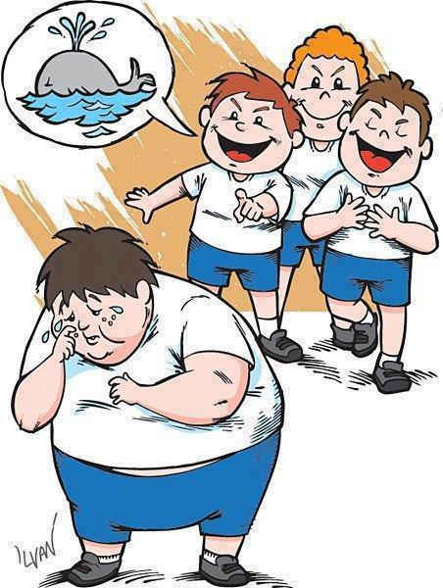
They just ignored me.
ignore /ɪɡˈnɔː/ refuse to take notice
If you keep it to yourself the bullies will just carry on.
Keep to yourself – don’t say anything about it
carry on – continue doing something

