Slide 1
The Silk Road
Picture dictionary

Slide 2
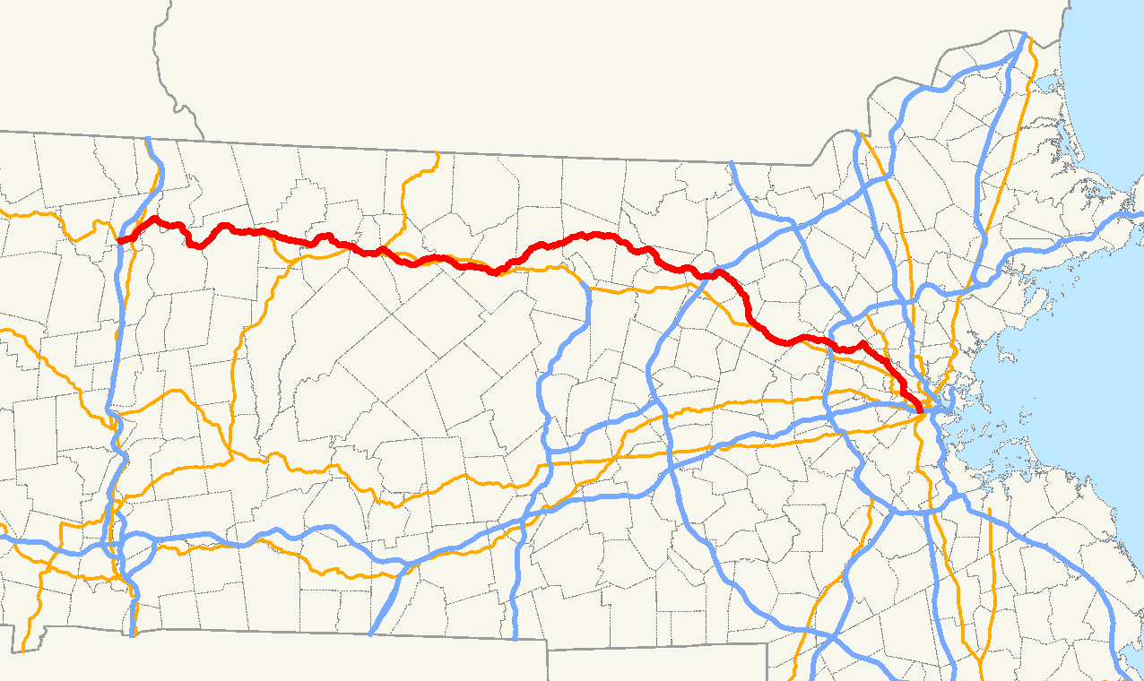
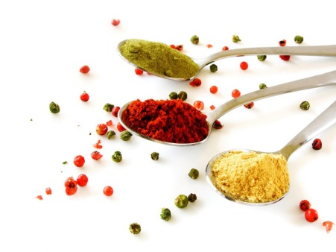
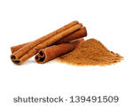
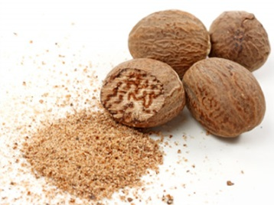
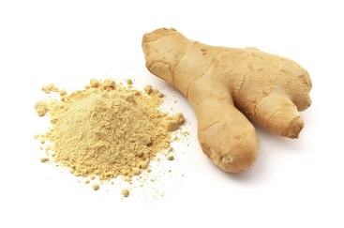
route /ruːt/ ruta, put
spice /spʌɪs/ začin
cinnamon /ˈsɪnəmən/
nutmeg /ˈnʌtmɛɡ/ muškatni oraščić
ginger /ˈdʒɪndʒə/ đumbir

Slide 3
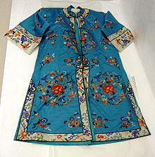
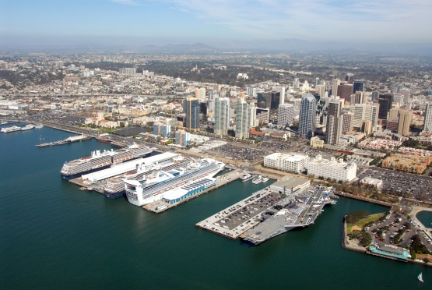
silk clothes
port /pɔːt/
century /ˈsɛntʃʊri/
merchant /ˈməːtʃ(ə)nt/

Slide 4
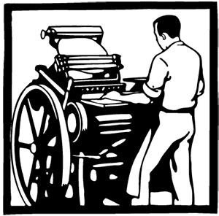
collapse /kəˈlaps/
printing /ˈprɪntɪŋ/
gunpowder /ˈɡʌnpaʊdə/ barut
eventually /ɪˈvɛntʃʊ(ə)li/ konačno, na kraju

Slide 5
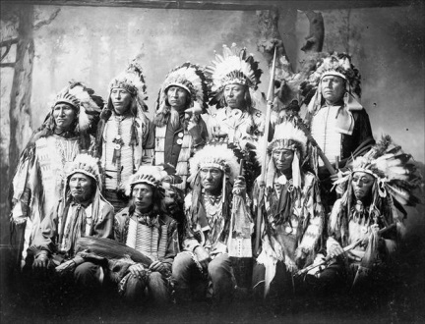
tax /taks/ porez
trade /treɪd/
explorer /ɛkˈsplɔːrə/ istraživač
tribe /trʌɪb/

Slide 6
Retell the story

Slide 7
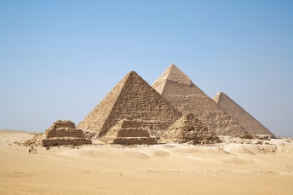
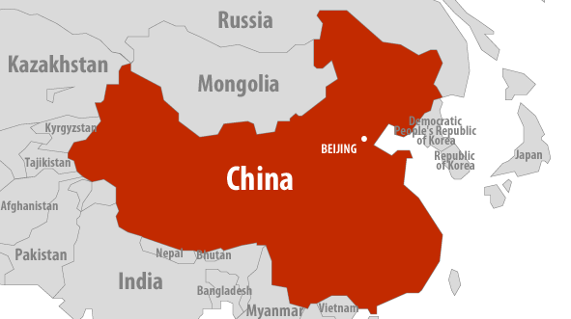
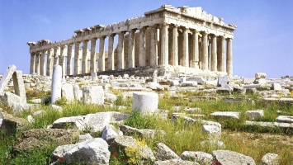
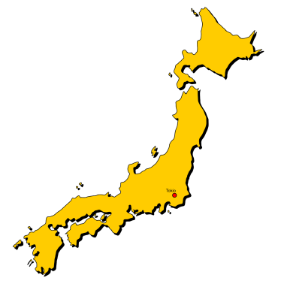
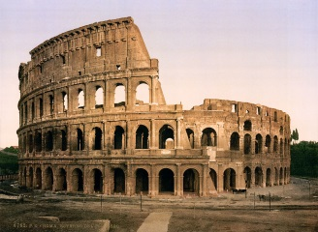
From about 115 BC

Slide 9
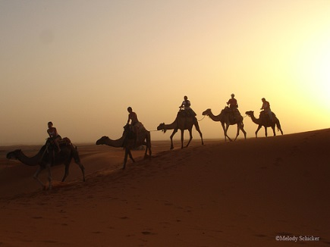
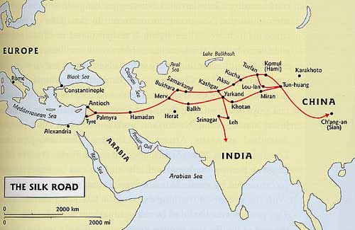
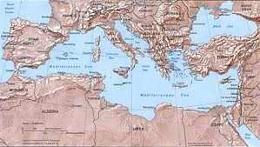
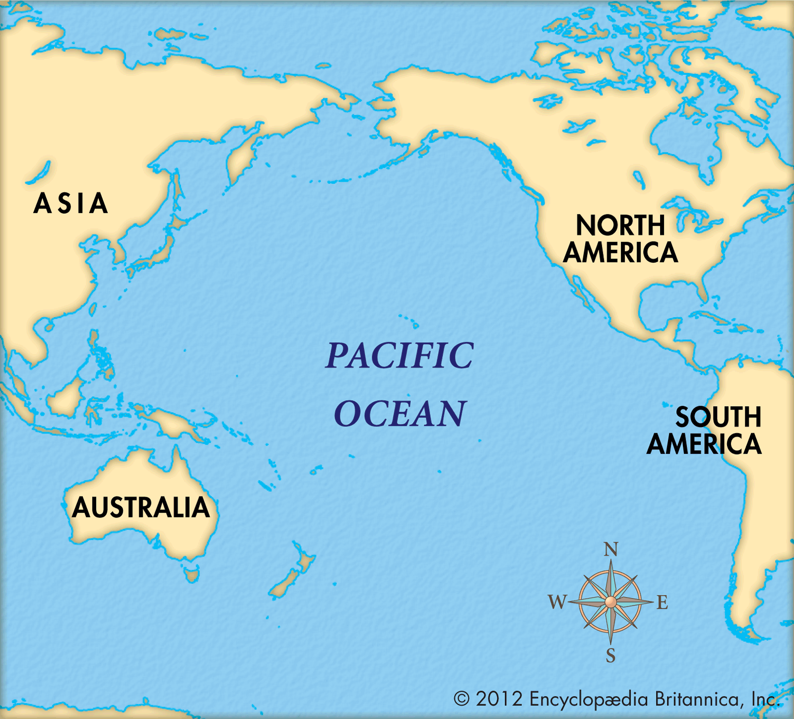
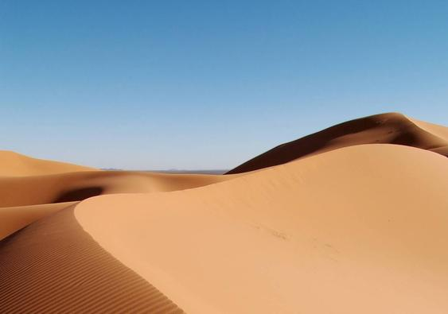
For several centuries
8000 km
In summer In winter

Slide 10
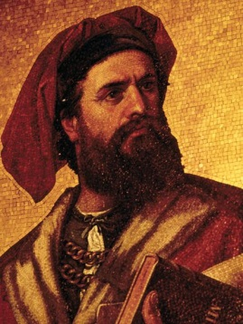
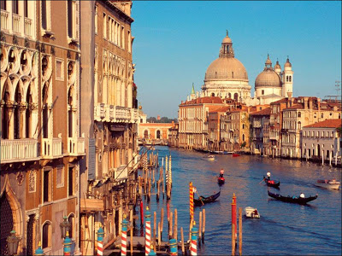
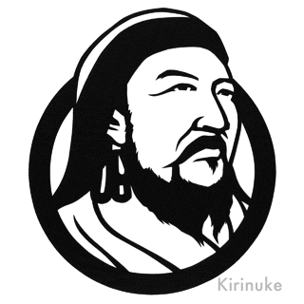
The Roman Empire

Slide 11
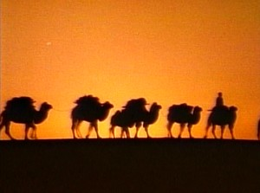
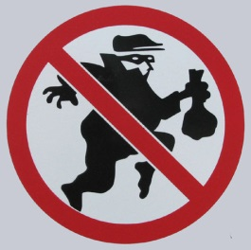
Eventually
By the end of the 15th century

Slide 12
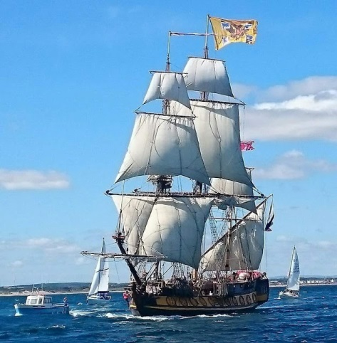
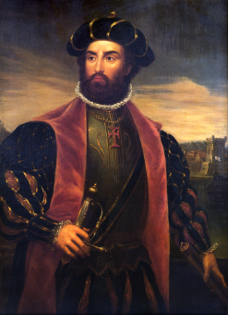
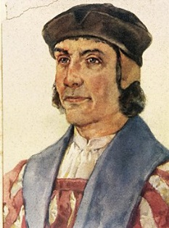
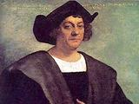
Europeans
Spain and Portugal
V. da Gama B. Diaz Ch. Columbus

