Slide 1
The story of Chicken Licken
Vocabulary

Slide 2
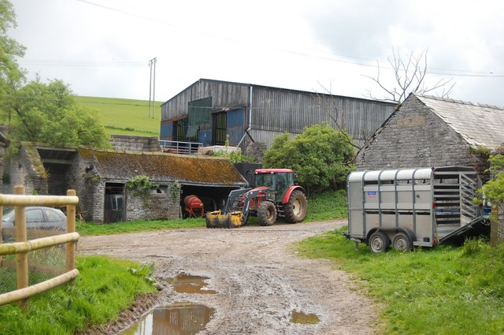
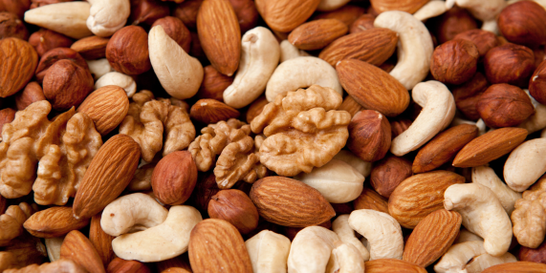
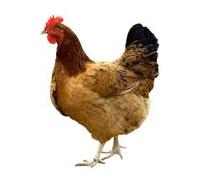
Chicken Licken is in the farmyard.
A nut falls on his head.
Henny Penny is a hen.
farmyard /ˈfɑːmjɑːd/ an area near farm buildings
nut /nʌt/ a ​dry piece of ​fruit in a hard ​shell
hen /hen/ a female chicken

Slide 3
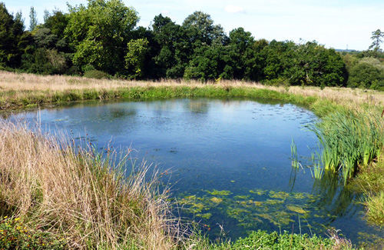
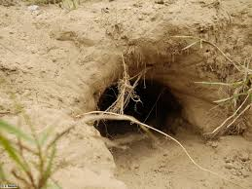
They are swimming on the pond.
Foxy Loxy takes them to his den.
pond /pɒnd/ an area of water smaller than a lake.
den /den/ a hole in the ground where animals live
:

