Slide 1
School subjects
Vocabulary

Slide 2
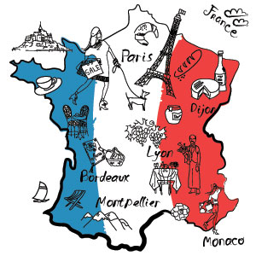
Art and Design
English
French
Italian

Slide 3
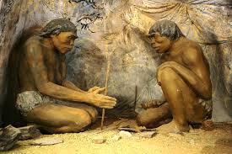
Geography
History
Maths
ICT (Information and Communication Technology)

Slide 4
RE (Religious Education)
Music
PE (Physical Education)

Slide 5
Physics
Biology Science
Chemistry

Slide 6
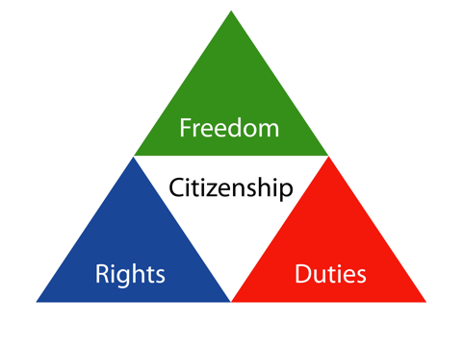
Design and Technology
Citizenship

