Slide 1
The Twelve Months
A Slav legend

Slide 2
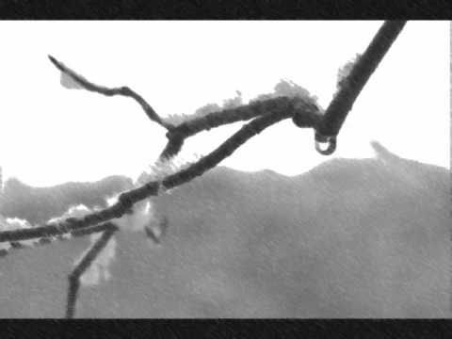
Vocabulary
A Slav legend
Once there was a widow.
The snow melted and flowers grew.
Slav /slɑːv/ refering to the Eastern European races of people
widow /ˈwɪdəʊ/ a woman whose husband has died
melt /melt/ to turn into liquid
grow /ɡroʊ/ to become bigger

Slide 3
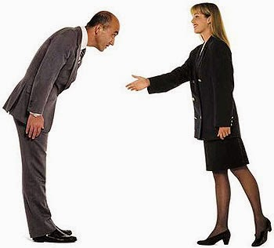
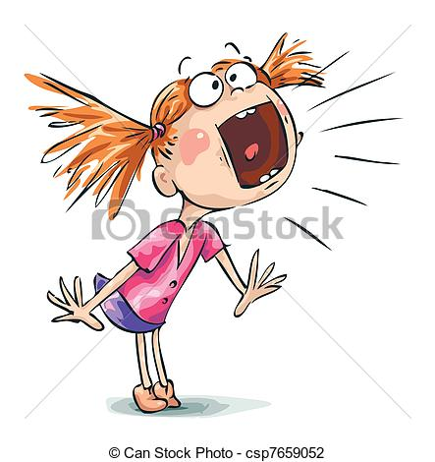
She was more polite than you.
Helen screamed: ‘Give me some apples!’
polite /pəˈlaɪt/ kind and friendly
scream /skriːm/ to cry or say something loudly

