Slide 1
FOOD AND DRINK

Slide 2
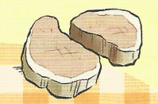
Can you name the food and drink?
chicken
(janjetina)
lamb
(svinjetina)
pork
(govedina)
beef

Slide 3
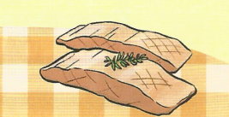
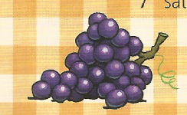
tuna
(losos)
salmon
satsumas
grapes
bananas

Slide 4
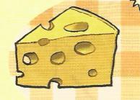
tomatoes
beans
lettuce
pasta
cheese

Slide 5
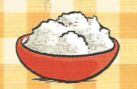
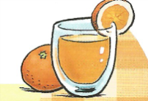
rice
eggs
orange juice
tea
coffee

Slide 6
lemonade
pancakes
mushrooms
(šunka)
ham
sausage

Slide 7
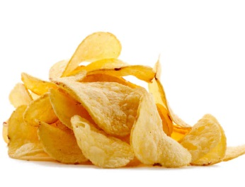
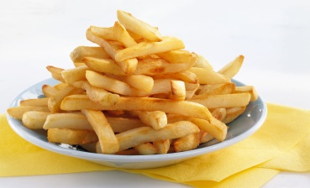
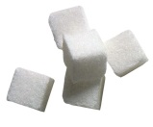
bread
water
crisps and chips
onion
sugar
salt

Slide 8
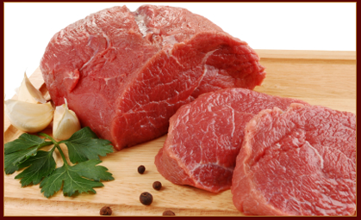
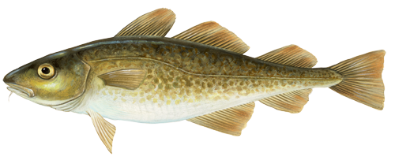
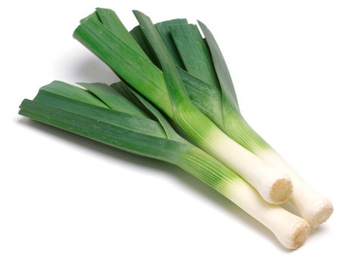
salami
teletina
veal
bakalar
cod
leek

Slide 9
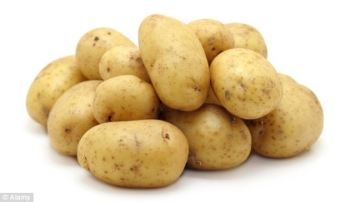
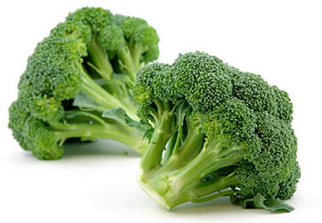
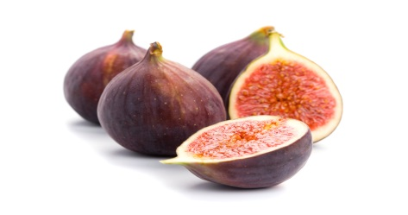
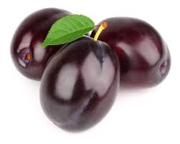
pear
potatoes
broccoli
figs
plums

Slide 10
cabbage
cream
pepper

Slide 11
yoghurt
butter
wine

