Slide 1
A surprise for Smart Alec
Unit 1B

Slide 2
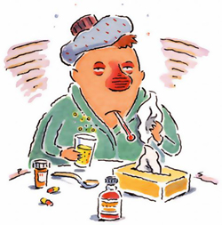
Vocabulary
An old clock disappeared.
Sweet Sue has got the flu.
He solved that case.
They arrested the thief.
disappear /ˌdɪsəˈpɪər/ no longer exists
flu /fluː/ an illness
solve /sɒlv/ to find an answer to a problem
arrest /əˈrest/ to put in prison
thief (pl. thieves) /θiːf/ a person who steals

Slide 3
The clock is in the parcel.
He wanted to repair the clock.
Sweet Sue has got a surprise for Smart Alec.
parcel /ˈpɑːsəl/ an object wrapped in paper
repair /rɪˈpeər/ to fix
surprise /səˈpraɪz/ an unexpected event

