Slide 1
Detective of the year
Vocabulary

Slide 2
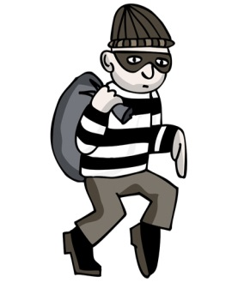
I’ll win the award.
Sweet Sue solved the bank robbery case.
Smart Alec will be jealous.
You weren’t in.
award /əˈwɔːd/ a prize
robbery /ˈrɒbəri/ the act of stealing
jealous /ˈdʒeləs/ unhappy and angry because someone has something that you want
You weren’t in the office.

Slide 3
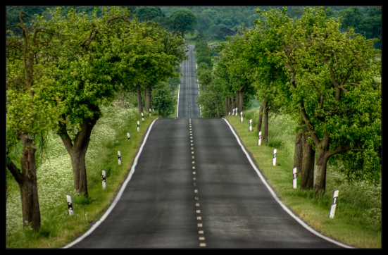
I am on my way now.
I am tired. I need a rest.
I don’t believe it!
On my way – arriving soon
I must relax.
believe /bɪˈliːv/ to think that something is true.

