Slide 1
James’s party
Vocabulary

Slide 2
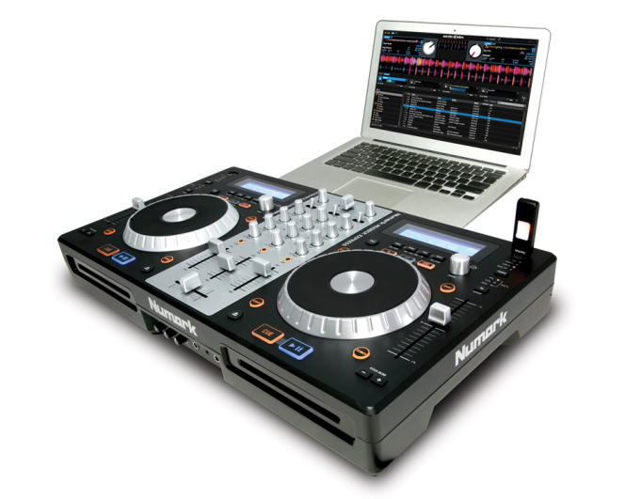
I am looking forward to your party.
DJ can’t make it.
It won’t be much of a party.
He says we can borrow his equipment.
to feel pleased and excited about something
- DJ can’t come.
- It won’t be a good party.
borrow /ˈbɒrəʊ/ to take something with the ​intention of giving it back
equipment /ɪˈkwɪpmənt/ necessary tools

