Slide 1
Journey into space
Vocabulary

Slide 2
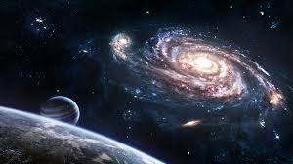
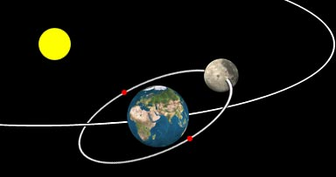
Journey into space.
The spaceship will leave the Moon’s orbit.
‘You still won’t have any brains.’ (=You will still be ignorant.)
journey /ˈdʒɜːni/ the act of travelling
space/speɪs/ the empty area where planets and stars are
orbit /ˈɔːbɪt/ a curved path around a planet or a star
brain /breɪn/ the organ inside the head.

Slide 3
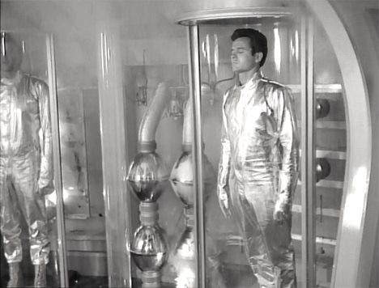
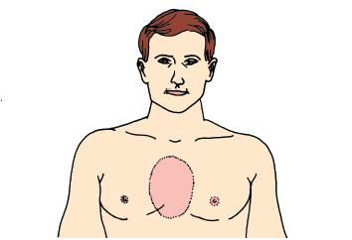
suspended animation – a state in which life in a body is slowed down or stopped.
look after – take care
chest /tʃest/ the upper part of the body between the neck and the stomach
You’ll be in suspended animation for the journey.
The robot will look after us.
He opened a small door in the robot’s chest.

Slide 4
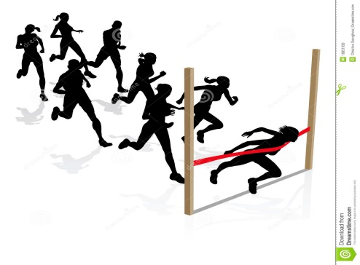
They picked up their bags.
I’ll race you to the room.
pick up – to lift
race – to run fast, to compete in a race.

Slide 5
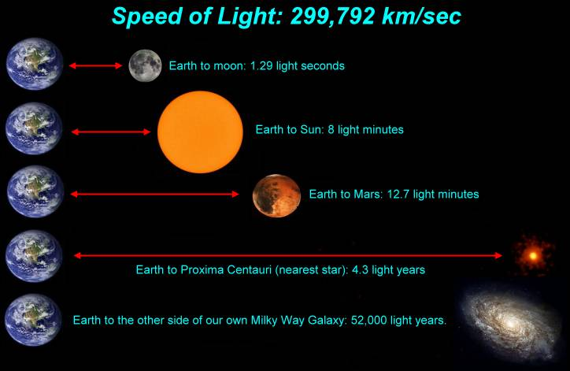
It is 20 light years from Earth.
light year - the distance that light travels in one year (about 9.5 million kilometres).

