Slide 1
The Solar System
Vocabulary

Slide 2
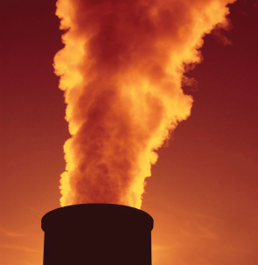
The Sun is one of billions of stars.
Large planets are made of gas.
Neptune is the furthest planet from the Sun.
billion /ˈbɪljən/ the number 1000,000,000
gas /ɡæs/ to be like air
furthest /ˈfɜːðɪst/ the superlative of far
(far, further, the furthest)
far - at the most distant point

Slide 3
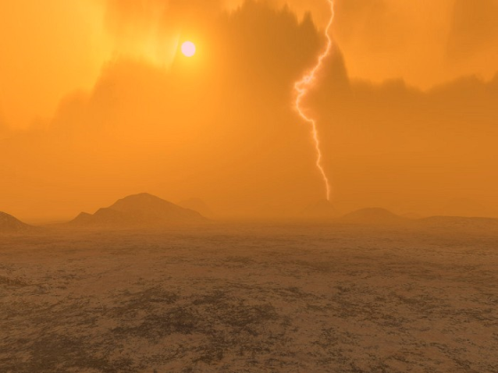
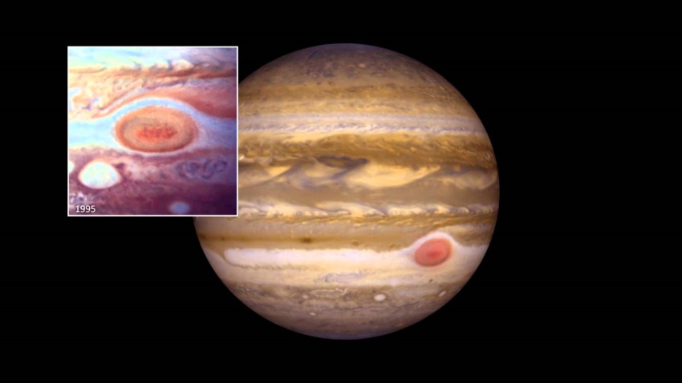
Venus has a thick, poisonous atmosphere.
There is a large red spot on the surface of Jupiter.
thick /θɪk/ dense; it is difficult to see through the atmosphere
spot /spɒt/ a ​small, round ​area
surface /ˈsɜːfɪs/ the outer part of something

Slide 4
Answer the questions.
What is in the center of the Solar System?
What is the Sun?
Which is the smallest planet in the Solar System?
Which is the largest planet in the Solar System?
Which is the hottest planet in the Solar System?
Why is Earth called a ‘Goldilocks Planet’?
7. How many moons has Jupiter got?
8. Why can’t you land on Jupiter?
9. What is the great red spot?
10. How many planets are there in the Solar System?

