Slide 1
Your Future
A questionnaire

Slide 2
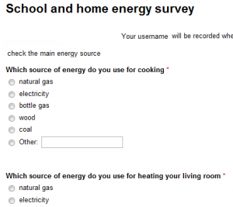
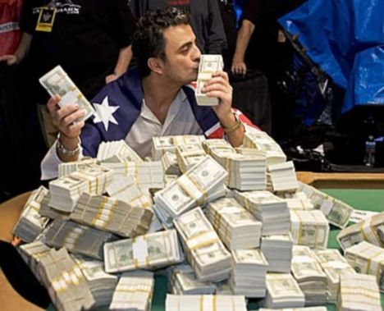
Vocabulary
A questionnaire
rich
questionnaire /ˌkwestʃəˈneər/ a list of questions
rich /rɪtʃ/ having a lot of money

Slide 3
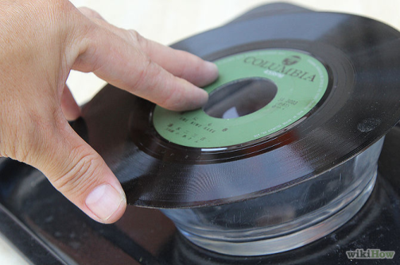
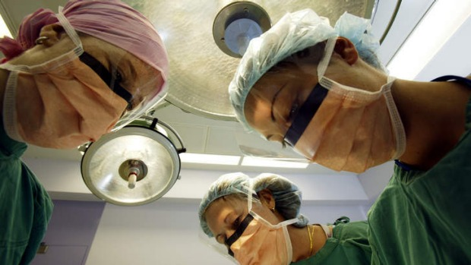
Appear on TV.
Make a record.
Scientists will cure all diseases.
appear /əˈpɪər/ to be present
record/ˈrekɔːd/ a plastic disc on which music is recorded.
cure /kjʊə/ to make someone healthy again
disease /dɪˈziːz/ an illness

Slide 4
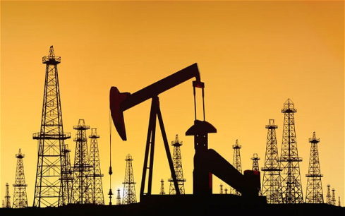
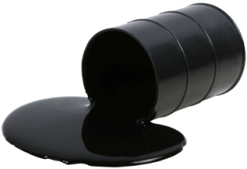
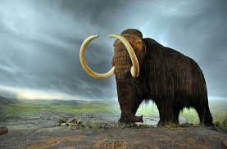
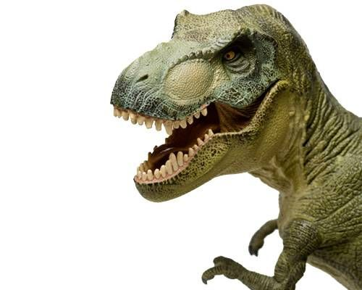
The world will have no more oil.
Many animals will become extinct.
oil /ɔɪl/ the black oil that can be found under the Earth's surface
extinct /ɪkˈstɪŋkt/ not existing

Slide 5
Fill in the blanks.
R.......... people are not always happy.
We don't use r..............nowadays; we use CDs instead.
Malaria is a very dangerous d.................. which is transmitted by mosquitoes.
Dinosaurs were e……………………about 65 million years ago.
Please, fill in the q…………………………...
Petrol is made from o……………………….
We can t…………………. rabies thanks to Louis Pastern.
Would you like to a……………….. in a TV reality show?

