Slide 1
Halloween

Slide 2
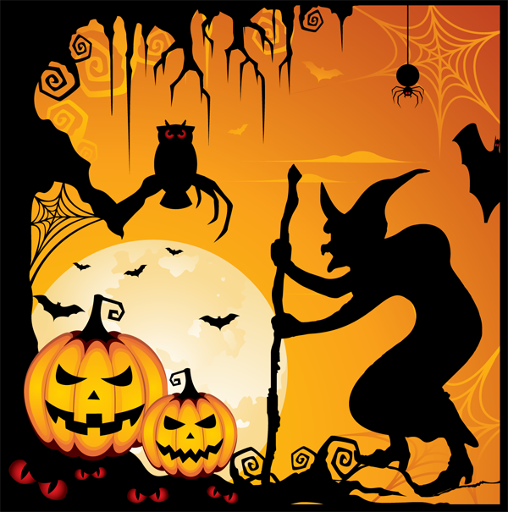
When is Halloween celebrated?
On 30th October
On 29th October
On 31st October

Slide 3
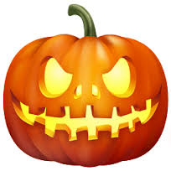
People make lamps from...
pumpkins
apples
pears

Slide 4
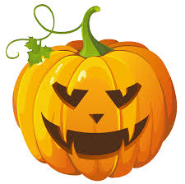
What do we call the pumpkin?
Jack-o’-Lanterns
Tom-o’-Lanterns
Peter-o’-Lanterns

Slide 5
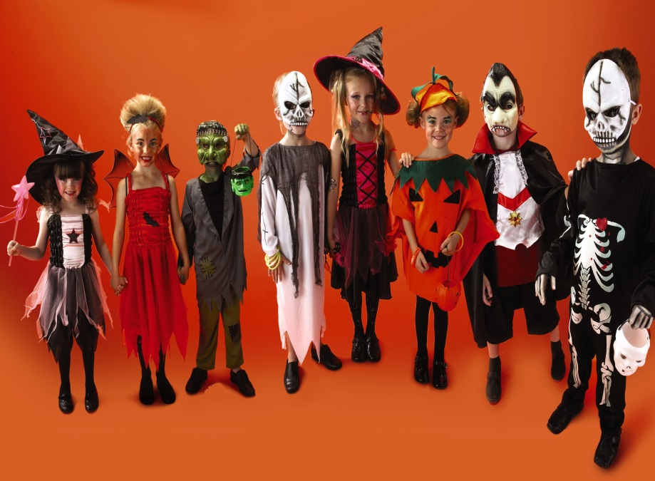
People usually dress up as...
animals and plants
pilots and sailors
witches, ghosts and skeletons

Slide 6
What do children do on Halloween?
Go to the cinema.
Go round, knock on people’s doors and ask for cookies and candies.
Go to bed early.

Slide 7
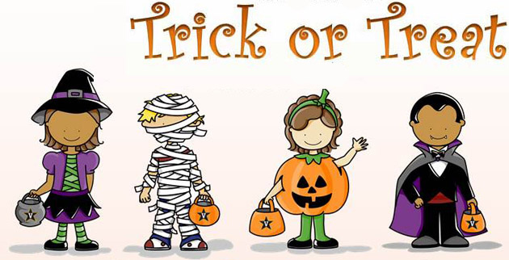
What do children call out when they visit their neighbours?
‘Abracadabra.’
‘Trick or treat.’
‘What day is it?’

Slide 8
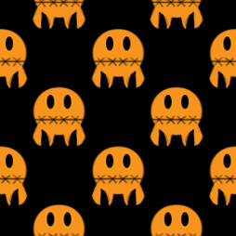
What colours symbolise Halloween?
White and red.
Pink and yellow.
Black and orange.

Slide 9
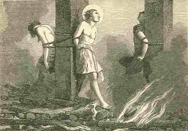
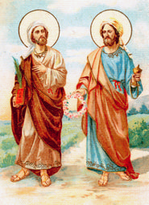
Who do we remember on Halloween?
Famous actors
The dead, saints and martyrs
Famous politicians

Slide 10
Trick or treat.
https://www.youtube.com/watch?v=pNWSaP6BW7M
https://www.youtube.com/watch?v=0goPyd588-M

