Slide 1
A dangerous situation
Vocabulary

Slide 2
An earthquake
A flood
Lightning
An avalanche
earthquake /ˈɜːθkweɪk/ a ​sudden ​violent ​movement of the earth's ​surface
flood /flʌd/ to ​become ​covered with ​water
lightning /ˈlaɪtnɪŋ/ ​bright ​light in the ​sky that is ​produced by ​electricity
avalanche /ˈævəlɑːnʃ/ ​​snow ​falling ​quickly down the ​side of a ​mountain

Slide 3
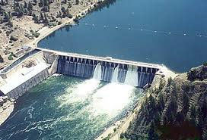
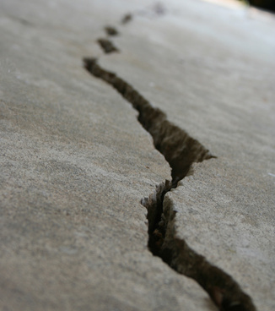
There was a dam at one end of the lake.
He saw a crack in the wall.
dam /dæm/ a ​wall ​built ​across a ​river that ​collects ​water
crack /kræk/ a very ​narrow ​space between ​parts of something

Slide 4
When I reached the town, I shouted, "The dam is breaking!”
People ran indoors.
The water picked up cars.
The water damaged a lot of cars and buildings.
reach /riːtʃ/ arrive at a place
indoors/ˌɪnˈdɔːz/ inside or into a building
pick up /pɪk/ lift
damage /ˈdæmɪdʒ/ to harm or spoil something

