Slide 1
Murder in the library
Vocabulary

Slide 2
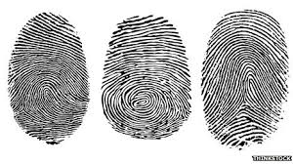
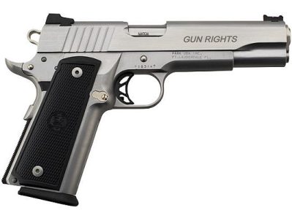
Murder in the library.
Was it an accident or did someone kill him?
There were no fingerprints on the gun.
murder /ˈmɜːdə/the ​crime of ​intentionally ​killing a ​person
accident /ˈæksɪdənt/ something ​bad that ​happens; it is not ​expected or ​intended
fingerprint /ˈfɪŋɡəprɪnt/ curved ​lines on the end of a ​finger or ​thumb that is different in every ​person
gun /ɡʌn/ a ​weapon

Slide 3
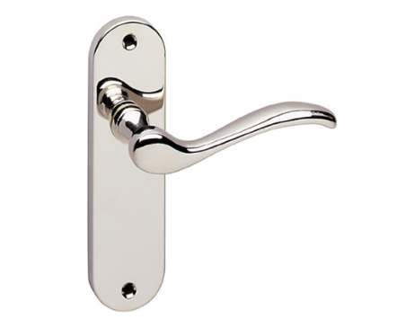
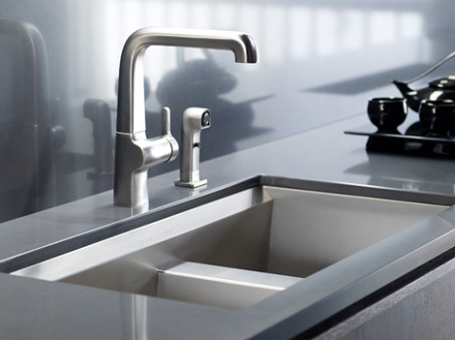
There were fingerprints on the handle of the library door.
Wilson is a butler.
There were some potatoes in the sink.
handle /ˈhændəl/ a ​part of an ​object ​designed for ​holding
butler/ˈbʌtlə/ the most important male servant in a house
sink /sɪŋk/ a ​bowl that is ​attached to the ​wall in a ​kitchen in which you ​wash ​dishes

Slide 4
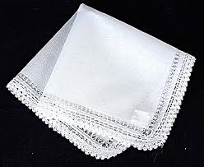
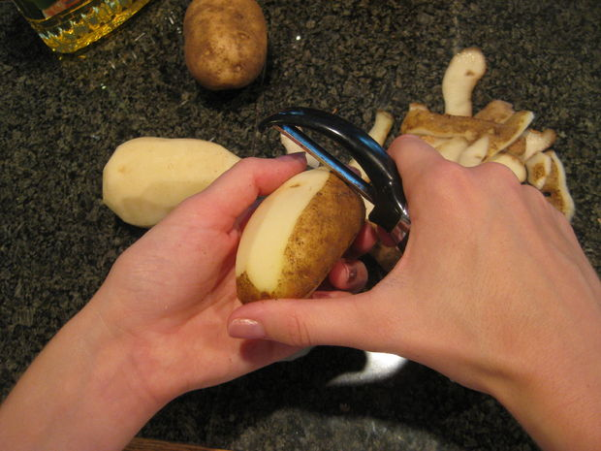
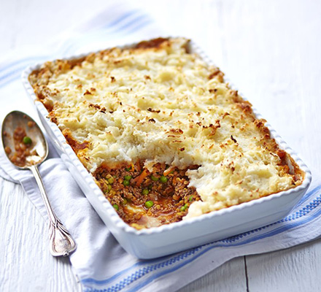
There was a white handkerchief on the floor.
She was peeling the potatoes to make a cottage pie.
handkerchief /ˈhæŋkətʃiːf/ a ​piece of ​cloth or ​paper used for ​cleaning the ​nose
peel /piːl/ to ​remove the ​skin of ​fruit and ​vegetables
cottage pie - a ​dish consisting of ​small ​pieces of ​meat and mashed ​potatoes
https://www.youtube.com/watch?v=GNGfELHp3_s

Slide 5
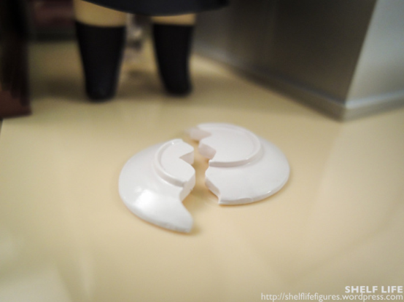
When he heard the shot, he dropped a plate.
drop /drɒp/ to ​allow something to ​fall

