Slide 1
Touching the Void (a true story)
https://www.youtube.com/watch?v=J9lRXpn8br0

Slide 2
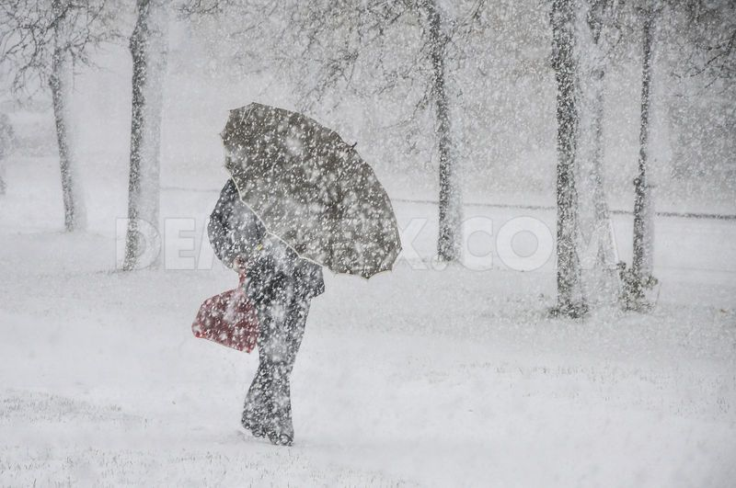
Vocabulary
There was a snowstorm on the way up.
void /vɔɪd/ empty space
snowstorm /ˈsnəʊstɔːm/ a heavy fall of snow with strong winds

Slide 3
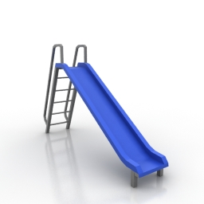
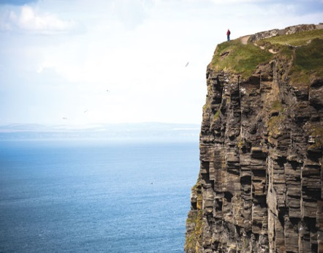
Simon has to lower Joe down the mountain on a rope.
Simon starts to slide down towards the cliff.
lower /ˈləʊə/ to move into a low position
rope /rəʊp/ a piece strong thick string
slide /slaɪd/ to move suddenly down a hill
cliff /klɪf/ a high area of rock

Slide 4
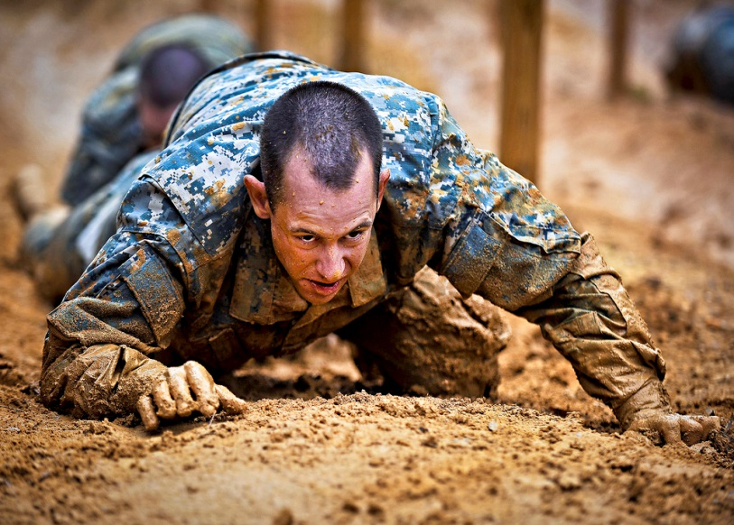
He crawls down the mountain.
They are going to leave the camp.
If Joe reaches the camp, there will be nobody there.
crawl /krɔːl/ to move slowly on hands and knees
leave /liːv / to go away
reach /riːtʃ/ to arrive at a place

Slide 5
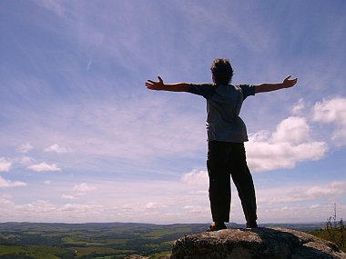
Richard and Simon rush out of their tent.
Joe has survived.
rush /rʌʃ/ run
survive /səˈvaɪv/ to be alive

