Slide 1
What happened to John Ross?
Retell the story!

Slide 2
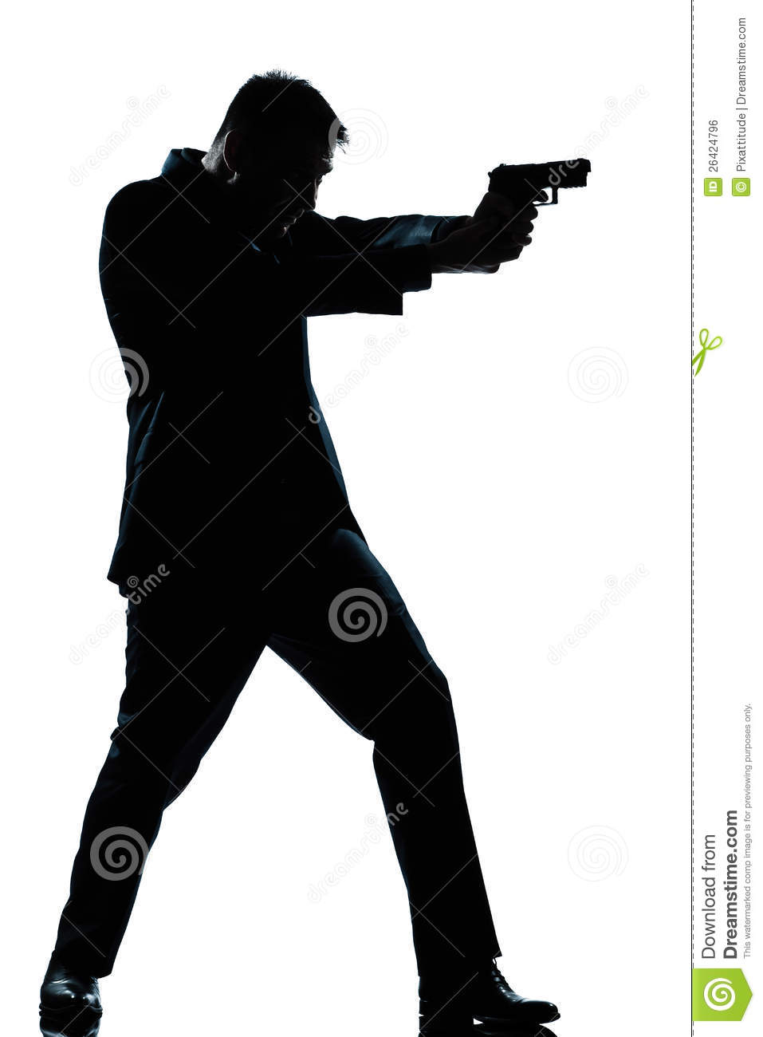
a film star died
at 2:10
a shot

Slide 3
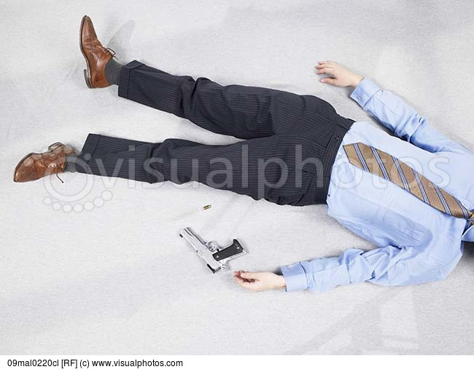
in the library
lie on the floor
a gun next to him

Slide 4
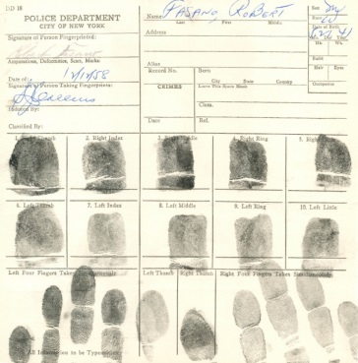
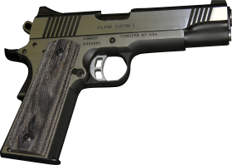
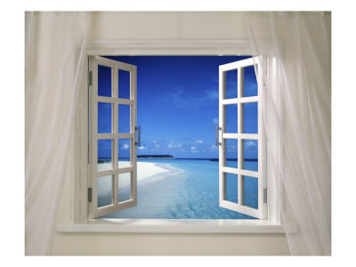
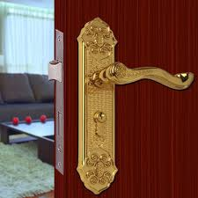
no fingerprints on the gun
the window
an empty cup
There were fingerprints on the...

Slide 5
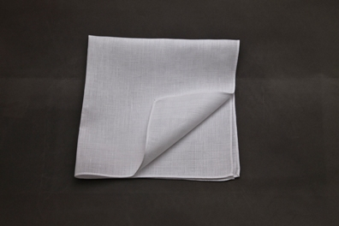
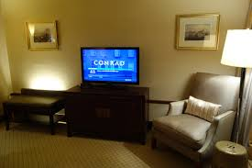
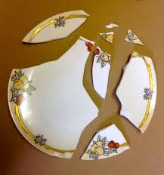
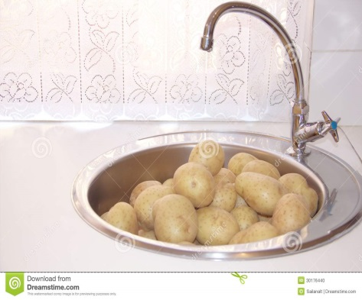
There was some oil...
In the living room...
In the dining room...
In the kitchen...
In the hall...

Slide 6
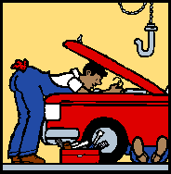
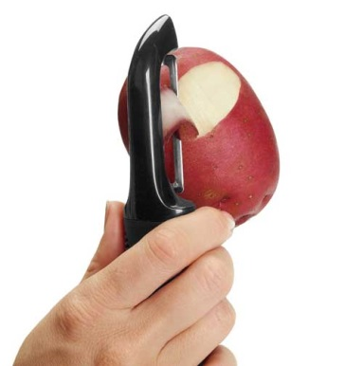
Adams, the chauffeur was...
Mrs Clare, the cook was...
Donna Ross, Mr Ross’s stepdaughter was...

Slide 7
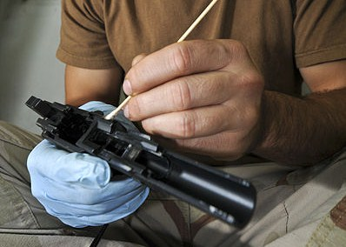
At two o’clock Wilson, the butler...
Mr Ross was...

Slide 8
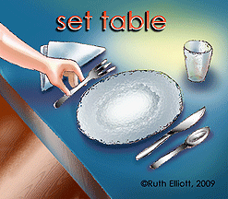
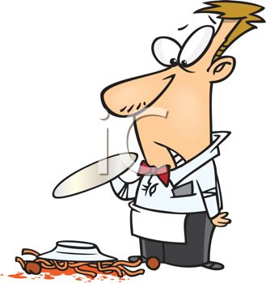
At 2:10 Wilson was...
Then he heard....
dropped...and ran...

