Slide 1
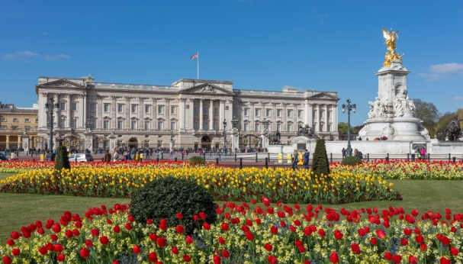
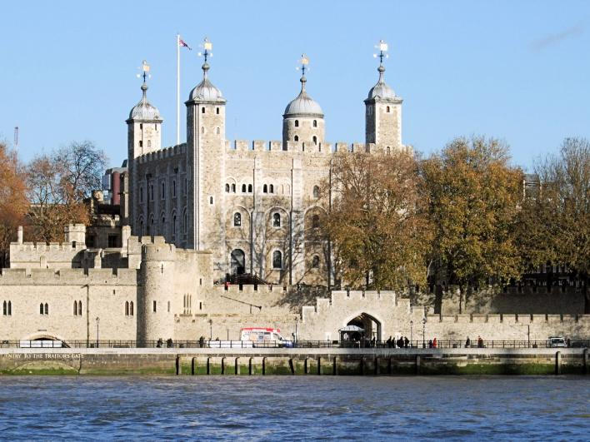
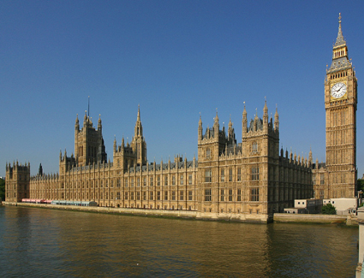
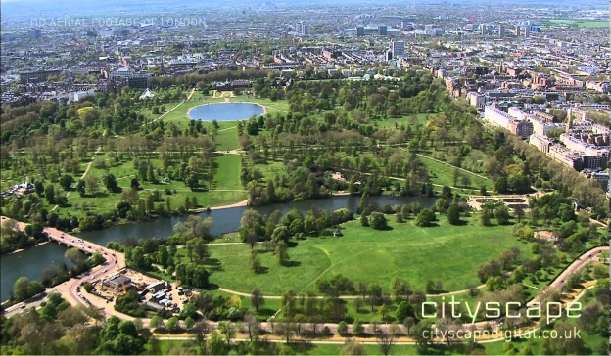
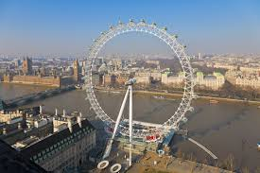
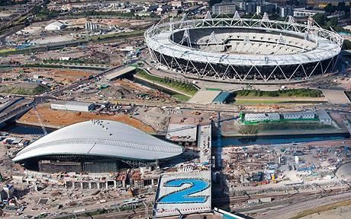
London

Slide 2
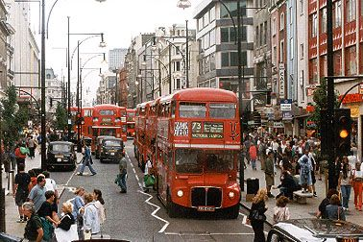
Oxford Street is famous for its shops.
Queen of England lives in Buckingham Palace.

Slide 3
The Houses of Parliament and Big Ben are in the centre of London.
Big Ben is the famous clock in England, but Big Ben is the name of the bell inside the clock tower.
The Olympic Park was built for the 2012 Summer Olympics.

Slide 4
The Tower of London is the oldest building in London. It is a museum today, but in the past it was a royal palace and a prison.
The London Eye is the biggest wheel in the world and you can see the whole London from the top.

Slide 5
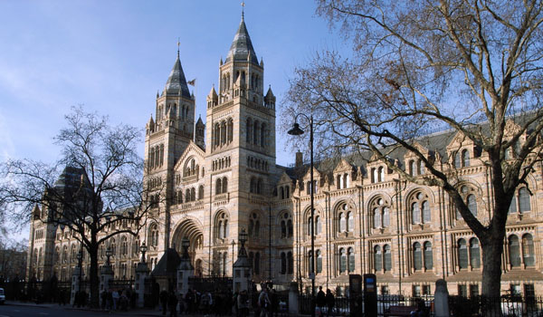
In the Natural History Museum you can see dinosaur bones.

Slide 6
Hyde Park is one of the largest parks in London with over 4,000 trees, a large lake and a meadow.

