Slide 1
New York
Manhattan
the centre of New York
an island
surrounded by three rivers
‘New York, New York’, a song

Slide 2
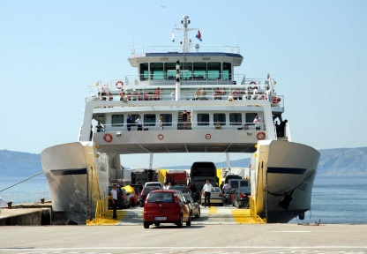
The Statue of Liberty
Liberty Island
gift /ɡɪft/ a present
ferry /ˈferi/
a ship that carries people and vehicles (cars, buses, motorbikes)

Slide 3
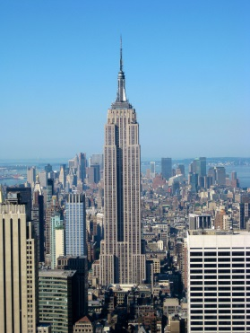
nickname /ˈnɪkneɪm/
an informal name for something or somebody
The Empire State Building
skyscraper /ˈskaɪˌskreɪpər/
a very tall, modern building

Slide 4
Times Square
an entertainment centre
entertainment /en.təˈteɪn.mənt/ to have fun

Slide 5
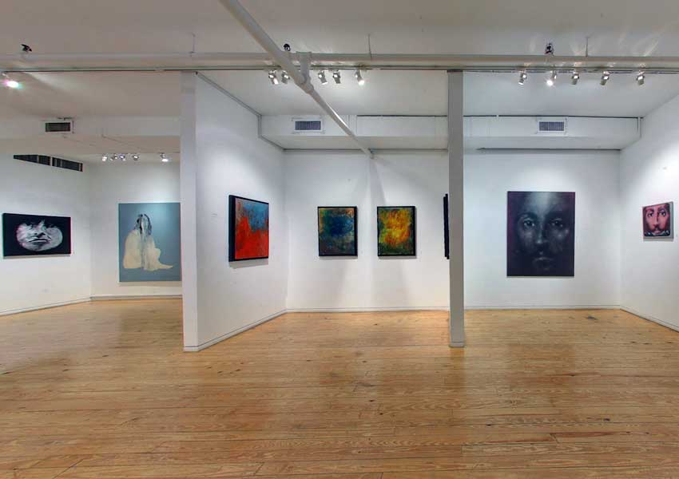
a museum
an art gallery

Slide 6
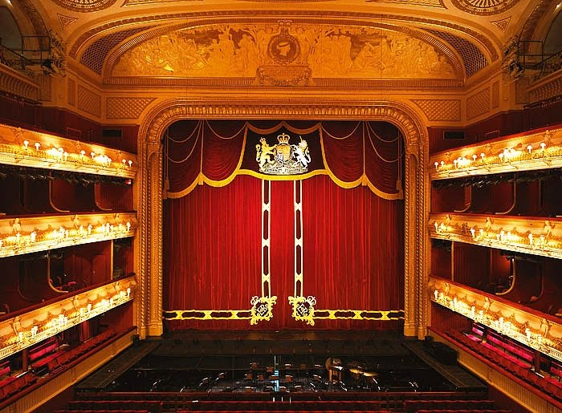
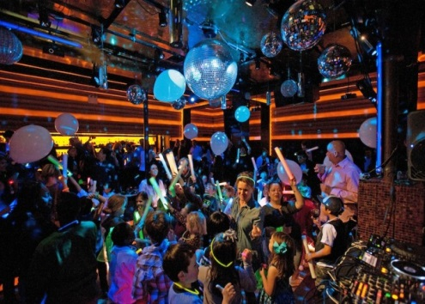
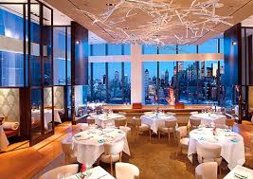
a theatre
a nightclub
a restaurant

Slide 7
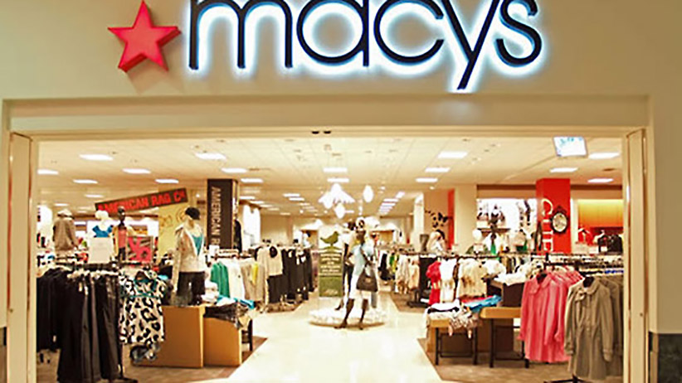
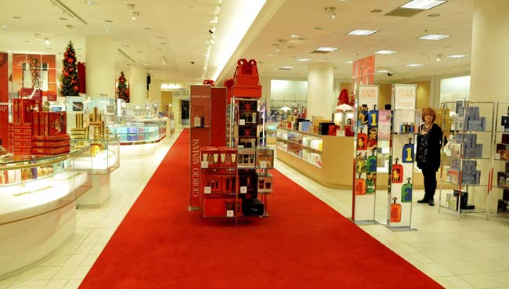
Macy’s
the biggest shop in the world

Slide 8
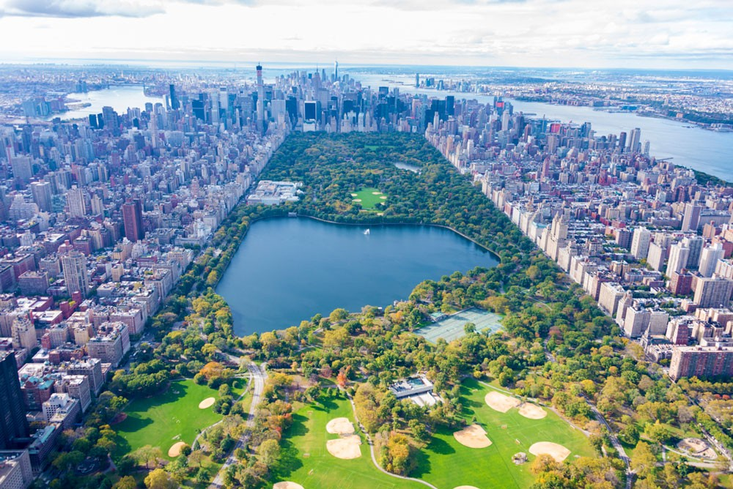
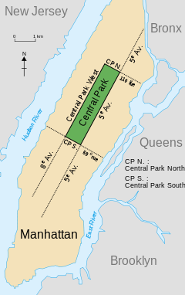
Central Park
‘the lungs of New York’
take a boat on the lake
bigger than Monaco and the Vatican

Slide 9
Listen to the recording. What are these things?
the Big Apple
the Empire State Building
New Amsterdam
Times Square
Manhattan
Central Park
the Statue of Liberty
Macy’s

Slide 10
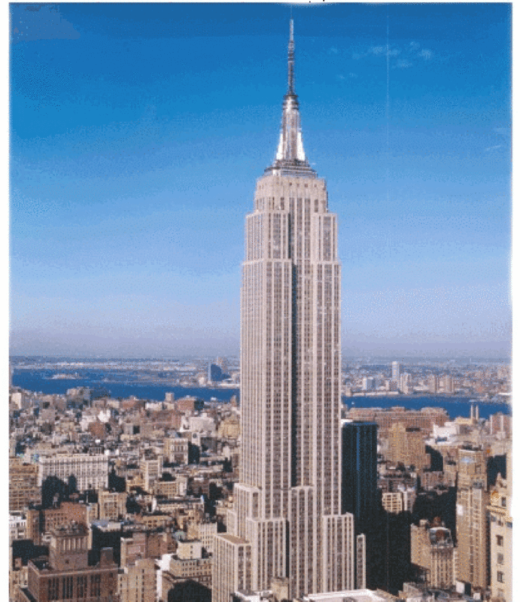
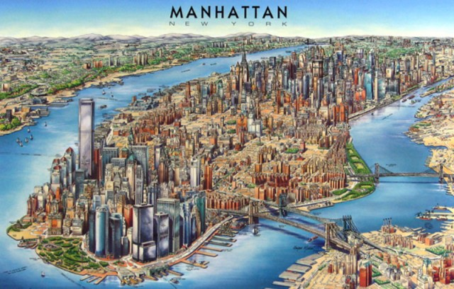
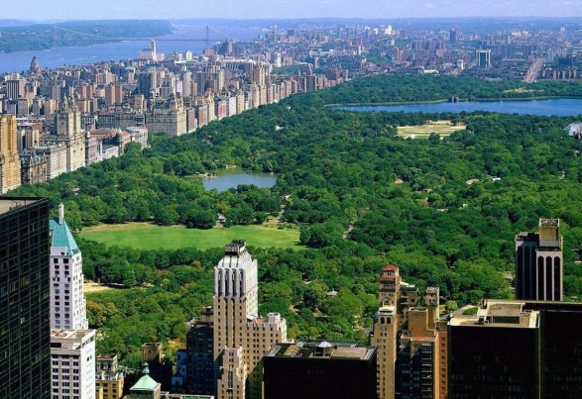
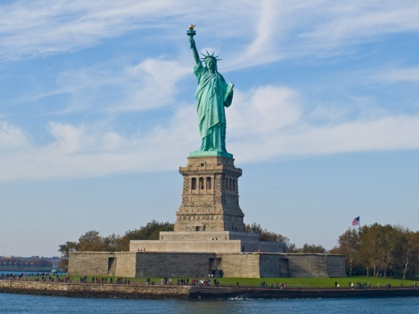
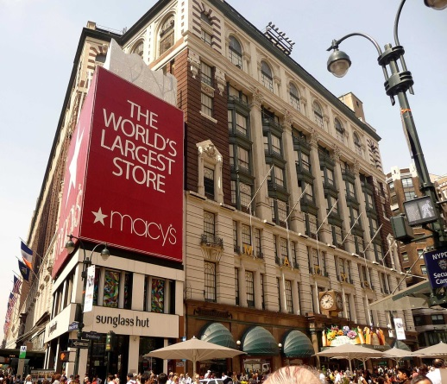
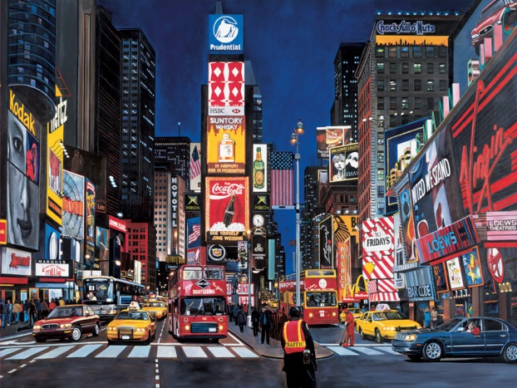
Read the text on page 52 and name the following places/buildings.
a) d)
b) e)
c) f)

Slide 11
Homework: Write a few sentences about:
A Dutchman, Peter Minuit.
Who called the city New York and why?
Macy’s.
The Statue of Liberty.
Manhattan.
6) Central Park.
7) The Empire State Building.
8) Times Square.
9) The Big Apple.

