Slide 1
The Tailor of Swaffham
Retell the story.

Slide 2
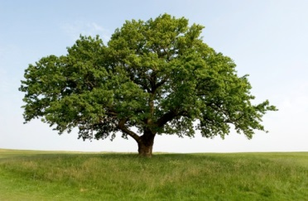
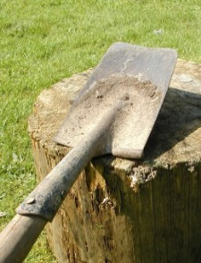
Vocabulary
tailor /ˈteɪlər/ a person who makes clothes
cottage /ˈkɒtɪdʒ/ a small house in the countryside
oak tree /əʊk/ hrast
treasure /ˈtreʒər/ valuable things
set off – to a start a journey
a busy place – prometno mjesto
pavement /ˈpeɪvmənt/ pločnik
dig /dıg/ kopati
shopkeeper /ˈʃɒpkiːpər/ a
person who owns a small
shop
grab /ɡræb/ take hold of something suddenly
spade /speɪd/ a tool used for digging

