Slide 1
The plague

Slide 2
The Great Plague of London
Choose the correct answer:
1) The Great Plague of London killed
A) over 1000 people
B) over 100 000 people
2) Dirty streets of Medieval London were
A) full of cows and goats
B) full of rats
3) Rats carried
A) fleas
B) flies
4) Doctors believed that the plague was caused by
A) bad smells
B) bacteria
5) Doctors wore long beaks filled with
A) water
B) herbs and flowers
6) When somebody died of the plague, the members of the family
A) left the house
B) were locked in the house for 40 days

Slide 3
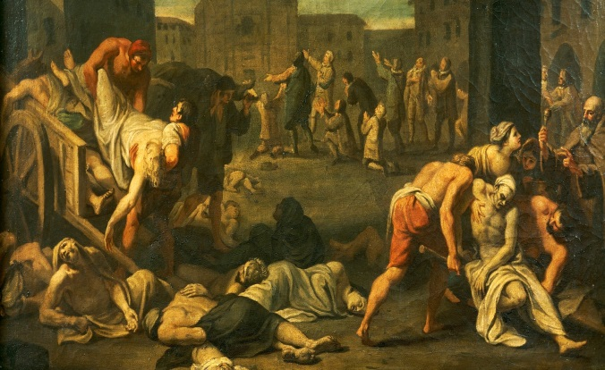
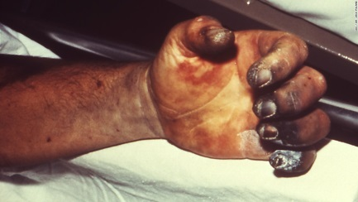
Vocabulary
The plague broke out in Europe in the 14th century.
People carried bunches of flowers.
break out – start suddenly
a bunch of flowers

Slide 4
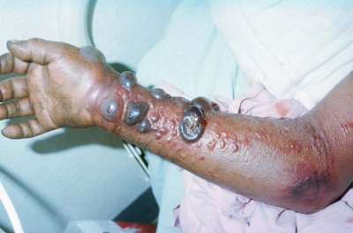
Bubonic plague
(black blisters)
bubonic plague /bjuːbɒnɪkˈpleɪɡ/
a very ​infectious ​disease ​spread by ​rats, ​causing ​swelling, ​fever, and usually ​death. In the 14th ​century it ​killed ​half the ​people ​living in ​Europe.

Slide 5
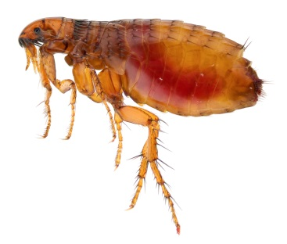
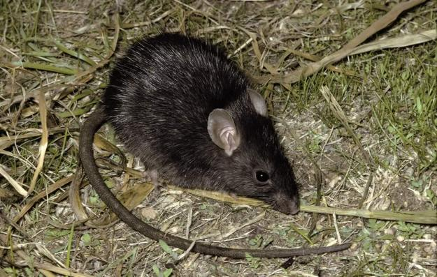
Fleas carried the plague.
The fleas lived on black rats.
The disease spread quickly in towns.
flea /fliː/ a small jumping insect that feeds on the blood
rat /ræt/ a small rodent with a long tail
spread (spread, spread, spread) /spred/ to develop in a large area

Slide 6
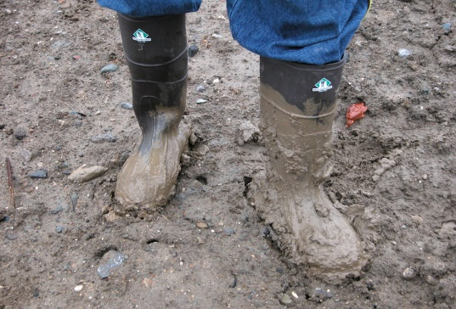
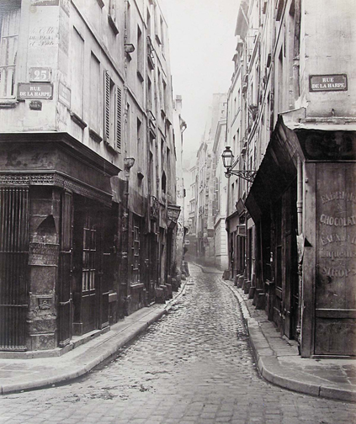
Most of the buildings were made of wood and mud.
Streets were narrow and dirty.
mud /mʌd/ earth mixed with water
narrow /ˈnærəʊ/ a small distance from one side to the other

Slide 7
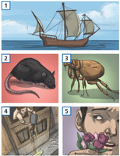
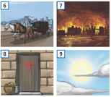
Retell the story of the plague

