Slide 1
Experiences
Ambitions

Slide 2
Complete the phrases with the verbs.
a competition/a race
a UFO/a sports event
a place/friends
a bike/a horse
on TV/in a film
a bungee jump/karate
a go-kart/a racing car
see
visit
be
drive
win
do
ride

Slide 3
win
see
visit
a competition
a race
a match
a prize
a UFO
a sports event
a friend, a neighbour
a place
a foreign country

Slide 4
ride
be
do
drive
a horse, a camel
a bike, a motorbike
on TV
in a film
at home, at work, at school
a bungee jump, aerobics, athletics, gymnastics,
karate, judo, yoga
a go-kart, a car, a bus, a taxi

Slide 5
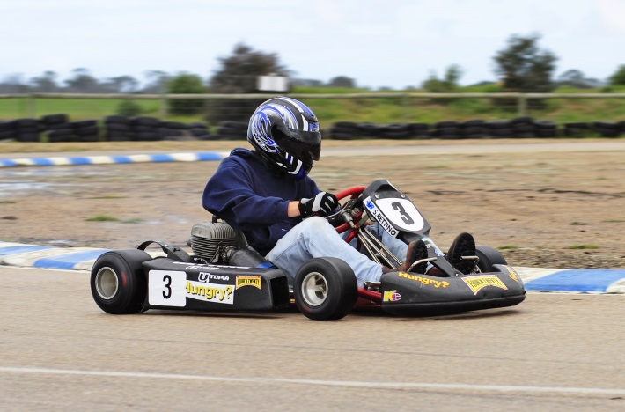
Keira Knightley starred in a lot of films.
She has done a lot of work for charities.
Brett has driven a go-kart lots of times.
star /stɑː/ to be the main actor in a film
charity /ˈtʃærɪti/ give money to ill and poor people
go-kart /ˈɡəʊkɑːt/ a small four-wheeled vehicle

Slide 6
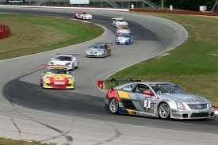
Brett doesn’t live near a racetrack.
racetrack /ˈreɪstræk/ a road on which cars or bikes race

