Slide 1
Making people aware

Slide 2
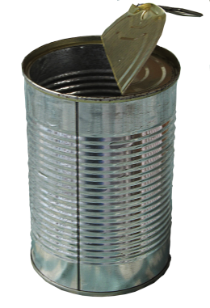
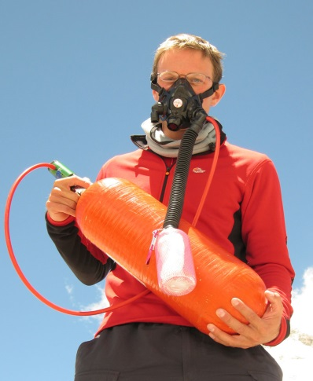
Ken Noguchi collects rubbish.
rubbish /ˈrʌbɪʃ/ junk, garbage, litter, trash, waste
He collects drinks cans, tents, oxygen bottles.
can /kən/ a metal container
oxygen bottle
/ˈɒksɪdʒən /ˈbɒtəl/

Slide 3
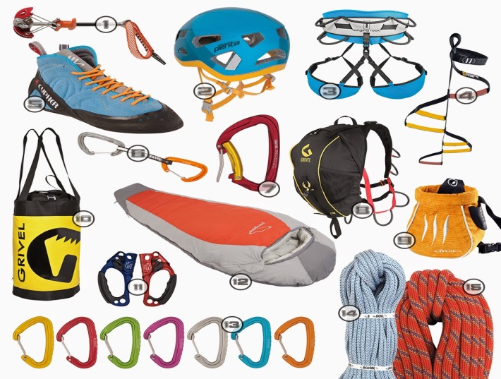
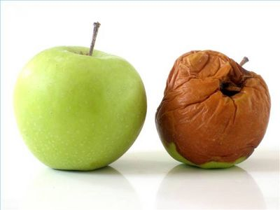
Modern equipment has made it easier to climb high mountains.
Rubbish doesn’t decompose in the cold air.
equipment /ɪˈkwɪpmənt/ necessary tools
decompose /ˌdiːkəmˈpəʊz/ decay

Slide 4
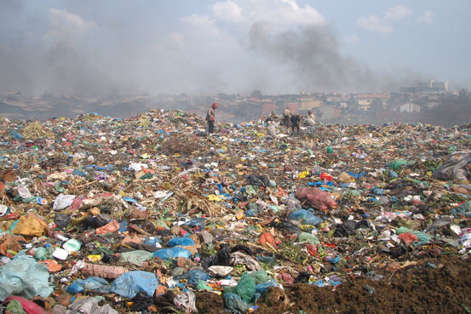
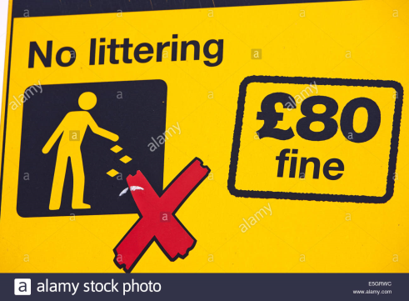
People call Mount Everest ‘ the highest rubbish dump in the world’.
Ken wants to make people aware of the problem.
He has put some rubbish on display.
Climbers must bring their own rubbish back or pay a big fine.
dump /dʌmp/ a place where people leave their rubbish
aware /əˈweər/ knowing that something exists
display /dɪˈspleɪ/ show something to people
fine /faɪn/ pay money as a punishment

Slide 5
Write the words and translate them.
............ /ˈrʌbɪʃ/
............ /kən/
........... /ˈɒksɪdʒən /ˈbɒtəl/
........... /ɪˈkwɪpmənt/
........... /ˌdiːkəmˈpəʊz/
............ /dʌmp/
............. /əˈweər/
........... /dɪˈspleɪ/
........... /faɪn/

Slide 6
a paper tissue
a foil tray
a bottle top
a drinks can
a plastic bag
food packaging
a crisp packet
a plastic bottle
a polystyrene cup
chewing gum
a cardboard box
a sweet wrapper

