Slide 1
Present Perfect

Slide 2

I have been to France.

Slide 3
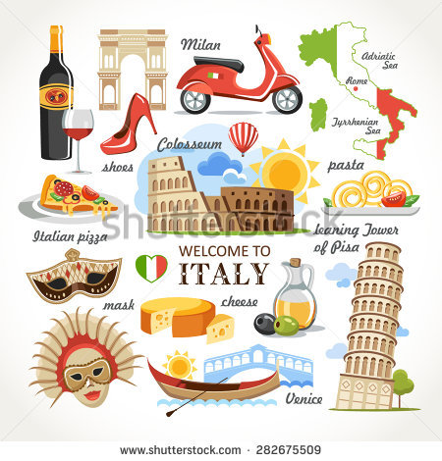
Italy
I haven’t been to Italy.

Slide 4
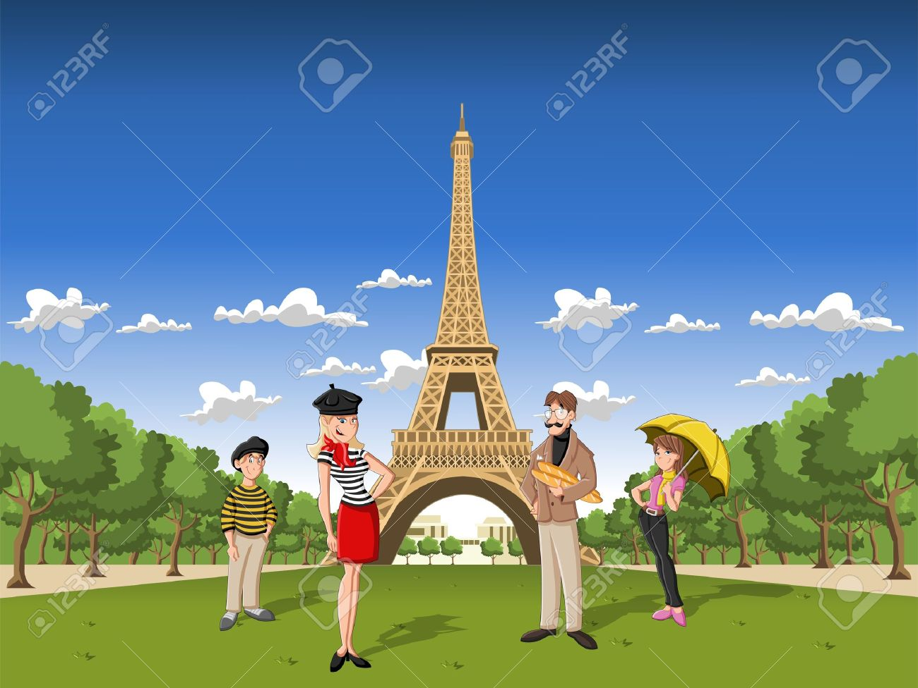
I have seen the Eiffel tower.

Slide 5
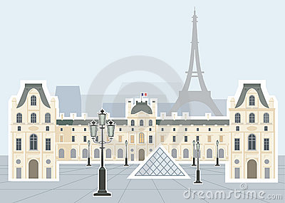
Louvre
I haven't seen the Louvre.

Slide 6
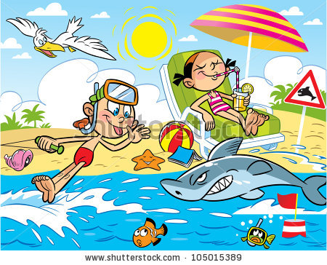
Lucy has been on a holiday.

Slide 7

home for two weeks
She hasn’t been home for two weeks.

Slide 8

She has done some diving.

Slide 9

surfing
She hasn't done surfing.

Slide 10
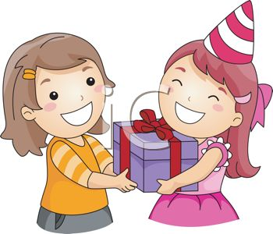
She has given her friend a present.
an idea (neg. sent.)
She hasn’t given her friend an idea.

Slide 11
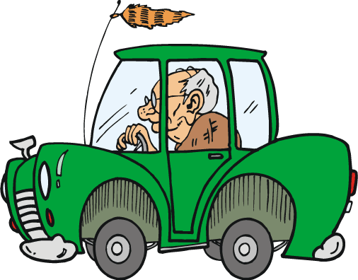
He has driven an old car.
a new car (neg. sent.)
He hasn’t driven a new car.

Slide 12
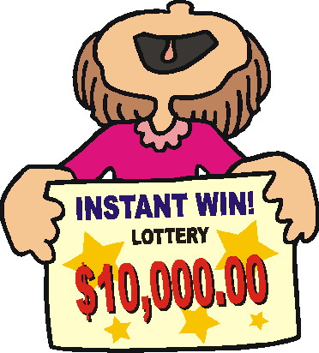
I have won the lottery several times.
a running race (neg. sent.)
I haven’t won a running race several times.

Slide 13
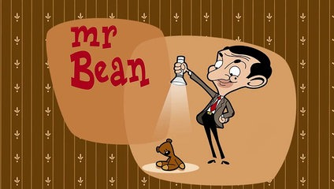
I have watched the movie Mr Bean three times.
the movie ET (neg. sent.)
I haven’t watched the movie ET three times.

Slide 14


Mum ...... vegetable soup for dinner.
a) has cooked
b) has coked
c) have cooked

Slide 15
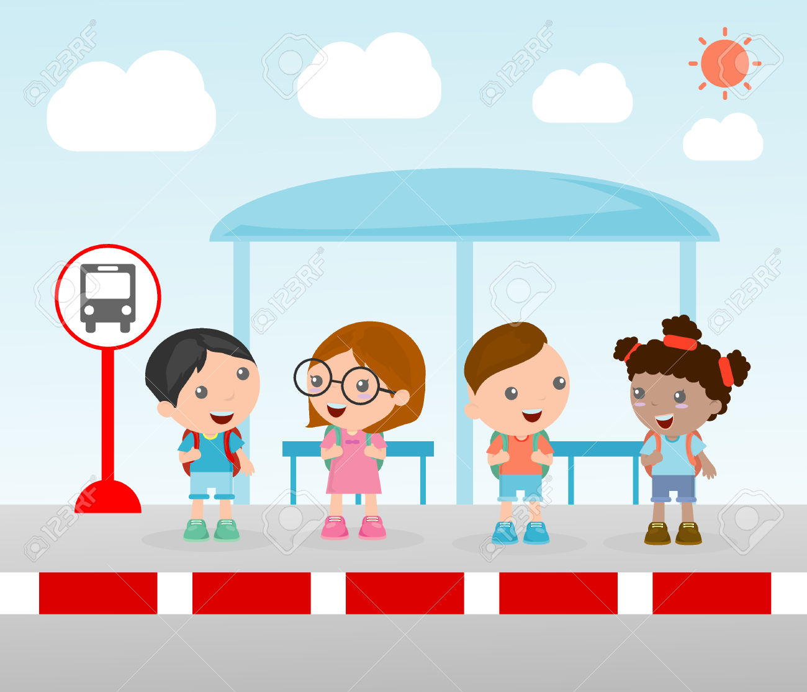
The students ..... for the school bus for twenty minutes.
a) have wait
b) has waited
c) have waited

Slide 16
We … the Maths homework.
a) has done
b) have did
c) have done

Slide 17
Daisy … the first prize.
a) has winned
b) has won
c) have won

Slide 18
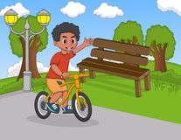
My friend .... his new bike in the park
has ride
have ridden
has ridden

Slide 19
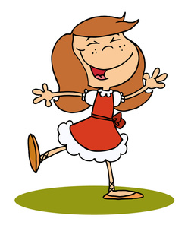
She ... happy all day.
have been
has been
has be

Slide 20
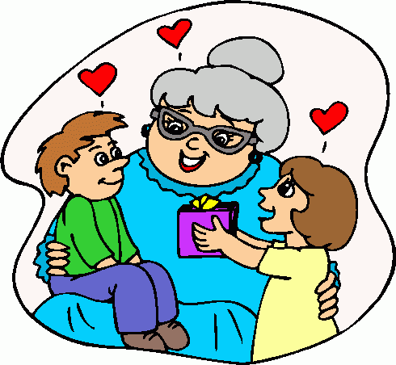
They ... their grandma.
have visited
has visited
have visit

Slide 21

It is a great movie. I ... that movie many times.
have saw
have see
have seen

Slide 22
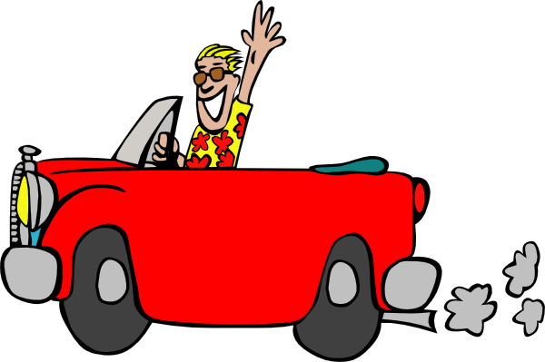
He has a car, so he ... there many times.
has driven
has drove
have driven

Slide 23
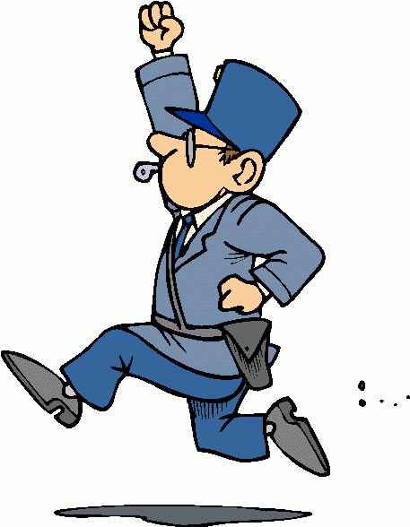
He _______ (be) a police officer for eight years.
has been

Slide 24
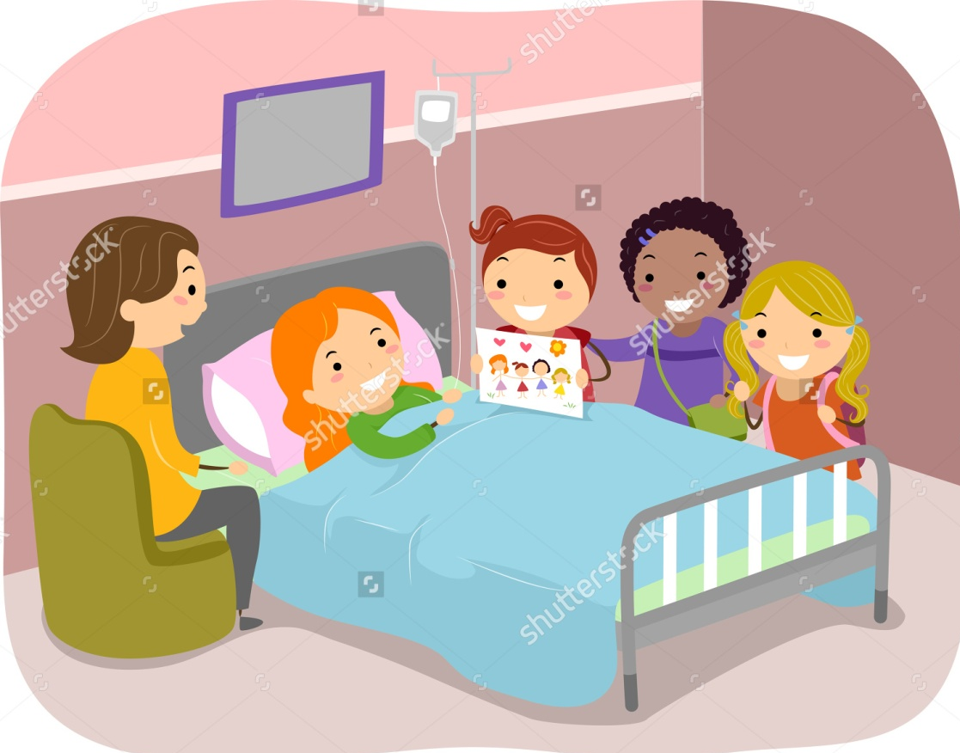
You _________ (visit) your friend at the hospital.
have visited

Slide 25
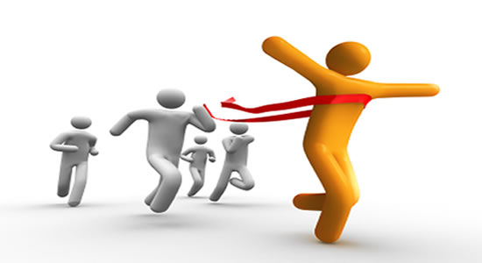
Number 12 _________ (win) the race.
has won

Slide 26
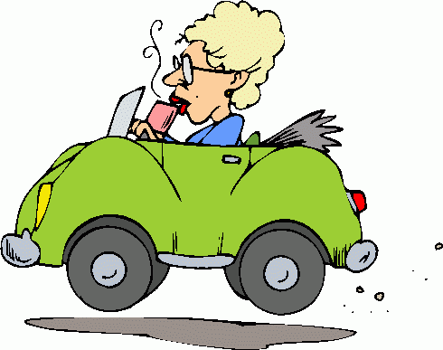
She _______ (drive) a little green car.
has driven

Slide 27

The girl ________ (see) an old friend.
has seen

Slide 28

They _________(not/be) to London.
haven’t been

Slide 29
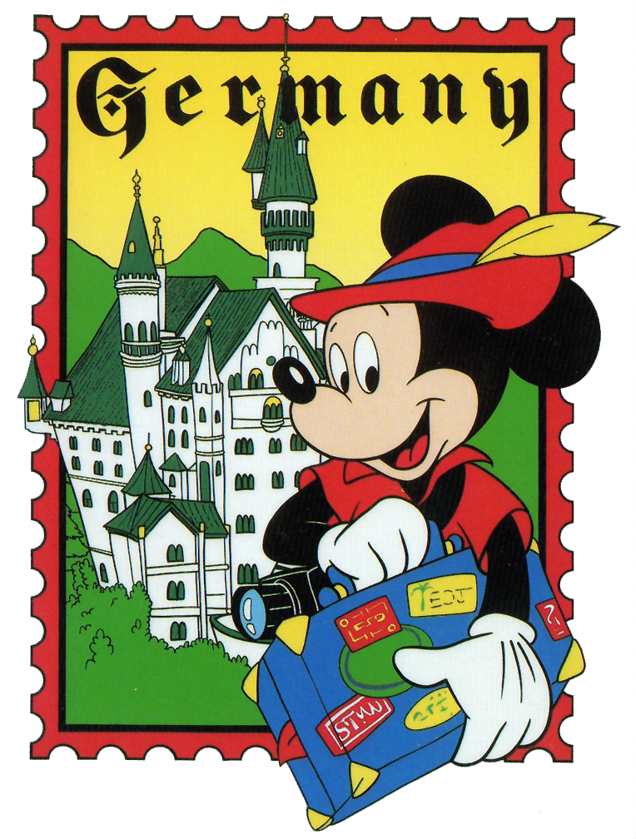
I __________ (not/visit) Germany yet.
haven’t visited

Slide 30
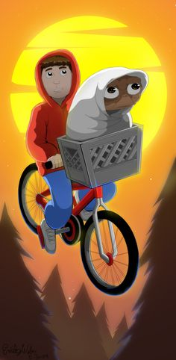
We __________ (watch) the film E.T.
have watched

Slide 31
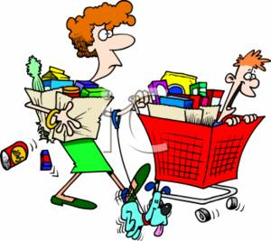
Mom ________ (do) the shopping.
has done

Slide 32

I ___________ (not/see) Peter this week.
haven’t seen

Slide 33
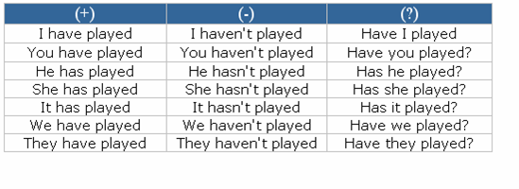
HAVE, HAS + Past Participle
I have seen a great film.
She has visited London many times.

Slide 34
Regular verbs
INFINITIVE | PAST SIMPLE | PAST PARTICIPLE
play live stop carry | played lived stopped carried | played lived stopped carried

Slide 35
Irregular verbs
INFINITIVE | PAST SIMPLE | PAST PARTICIPLE
be see do give drive win | was, were saw did gave drove won | been seen done given driven won

Slide 36
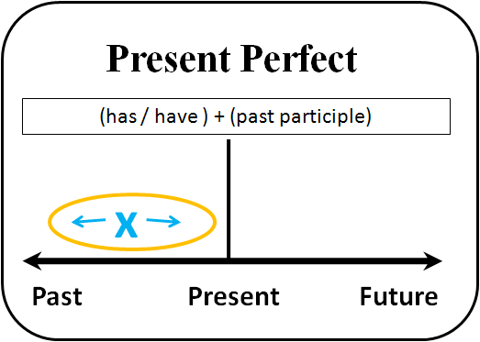
I lost my book last week. -> Past Simple
I have lost my book. -> Present Perfect

Slide 37
When do we use the Present Perfect?
Past Simple | Present Perfect Simple
For actions that happened in the past and we know exactly when. I played football yesterday. We went to the cinema last week. They visited London in 2010. She went home two hours ago. | For actions that happened in the past but we don’t know the exact time. I have watched ET. I have seen that movie many times. He has climbed Mount Everest twice.

