Slide 1
What has Smart Alec done?

Slide 2
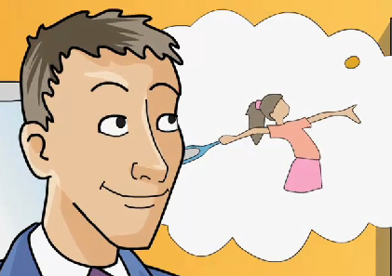
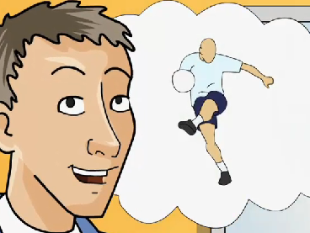
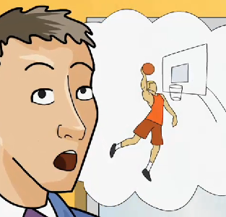
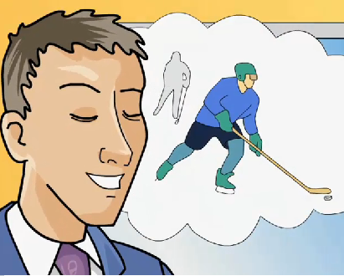
He has played golf.
He has played tennis.
He has played football.
He has played basketball.
He has played ice hockey.
He has won lots of trophies.

Slide 3
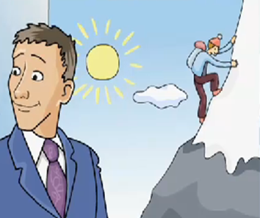
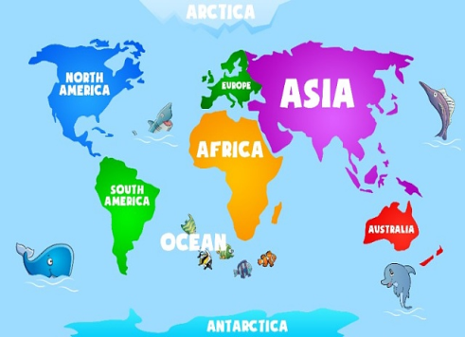
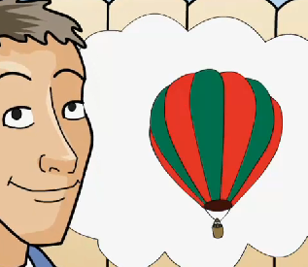
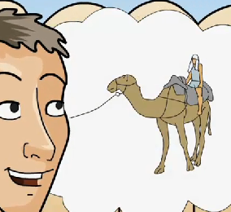
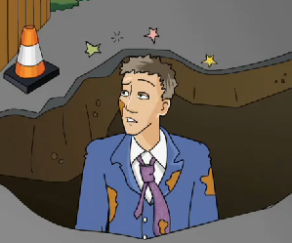
He has climbed Mount Everest twice.
He has travelled to every continent.
He has seen the pyramids in Egypt.
He has flown in a balloon.
He has ridden a camel.
He has fallen into a hole in the pavement.

