Slide 1
What have the people done?
The Present Perfect Simple

Slide 2
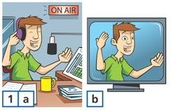
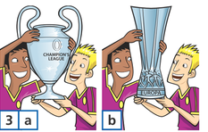
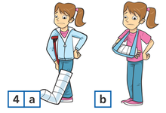
He has been on
the radio b) on TV
2) She has read
Oliver Twist b) Christmas Carol
3) The team have won
a)The Europa League b) the Champions League
4) She has broken
a) her arm b) her leg

Slide 3
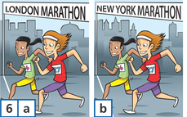
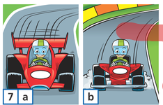
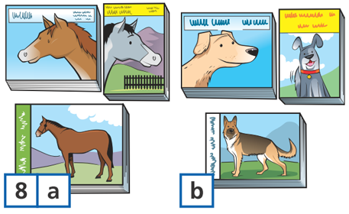
5) They have seen
Star Wars b) Casino Royale
6) They have done
The London Marathon
The New York Marathon
He has driven
a go-kart b) a racing car
8) She has written books
a) about horses b) about dogs

