Slide 1
Ashley’s camera - vocabulary

Slide 2
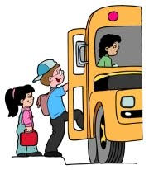
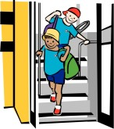
Ashley wanted to try out his digital camera.
try out /ˈtraɪaʊt/
He got off the bus in the High Street.
got off / got on (the bus)
They had to help the teacher with the register.
register /ˈredʒɪstər/
to test
a book with a list of names

Slide 3
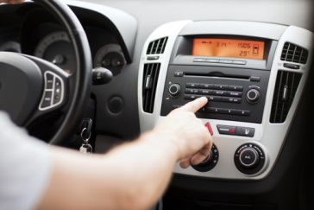
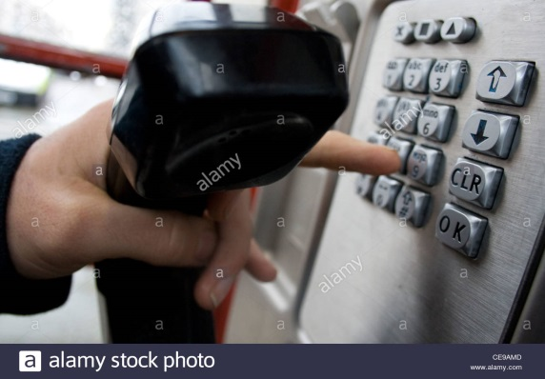
Ashley looked round for something else to snap.
snap /snæp/
He switched on the radio.
switch on / switch off
They were looking for him.
look for
He dialled 999.
dial /ˈdaɪəl/
to take a lot of photos quickly
try to find
choose numbers on the phone

Slide 4
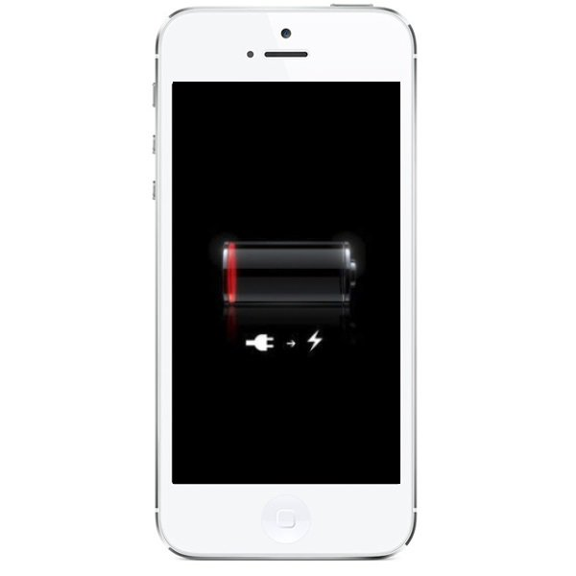
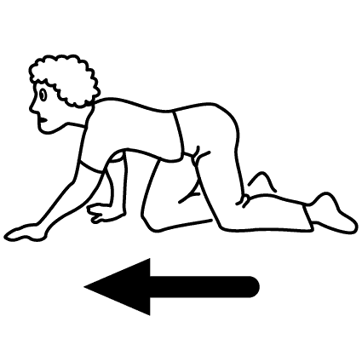
The battery was dead.
a dead battery
He decided to escape.
escape /ɪˈskeɪp/
He crept into the kitchen.
creep-crept-crept
an empty battery
run away
to move with the body close to the ground

Slide 5
to bump into somebody
Ashley ran straight into him.
run into somebody
The man fell backwards.

Slide 6
Write the words and translate them.
............... /ˈtraɪaʊt/
............... /’ɡet’ɒn/
............... /get ‘ɒf/
............ /ˈredʒɪstər/
.............. /snæp/
.............. /’swɪtʃ’ɒn/
.............. /’swɪtʃ’ɒf/
............. /’lʊk/’fɔː/
............. /ˈdaɪəl/
............ /ɪˈskeɪp/
........... /kriːp/
........... /’rʌn’ɪntuː/
........... /’fɔːl’bækwədz/

Slide 7
Retell the story

Slide 8
got up
opened
ate / left
wanted to try out
met
looked round / to snap
took some photos of
noticed / were carrying
arrived home / had to go
wanted to tell
didn’t hear

Slide 9
sat down /switched on
looked at
was on the radio
were looking for
were in his photos
knocked at
was
phoned / wasn’t working
tried /was dead
crept into /ran out of the
ran straight into/fell backwards

Slide 10
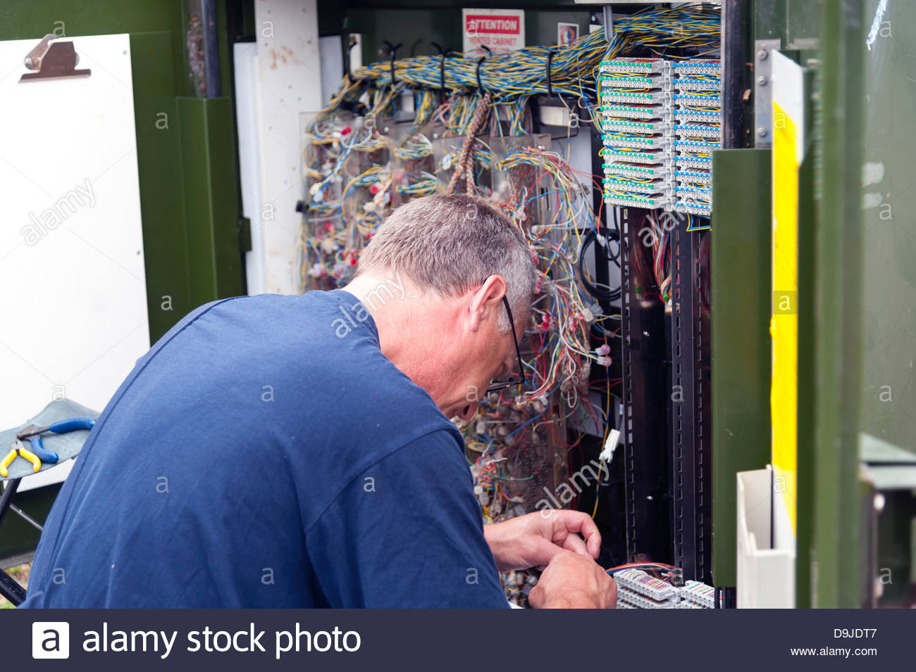
came
explained
was a telephone engineer
got up/brushed off
was repairing
laughed/was very embarrassed

