Slide 1
What’s the matter
Vocabulary

Slide 2
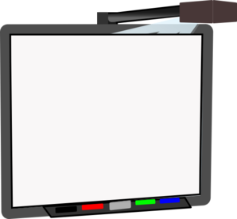
painkiller /ˈpeɪnˌkɪlər/
a drug that removes pain
properly /ˈprɒpəli/ correctly, in a satisfactory way
geek /ɡiːk/ nerd, freak, weirdo, štreber
neat /niːt/ nice, good
whiteboard /ˈwaɪtbɔːd/ a board connected to a computer

Slide 3
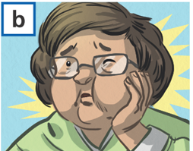
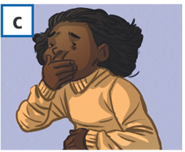
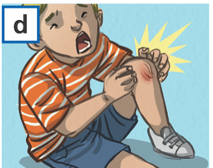
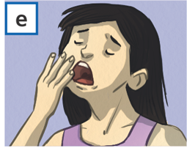
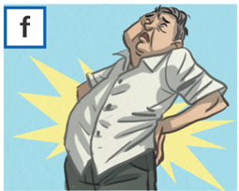
He’s thirsty.
She’s got a toothache.
She feels sick.
His knee hurts.
She is tired.
His back hurts.

Slide 4
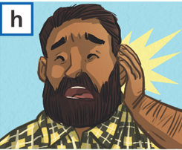
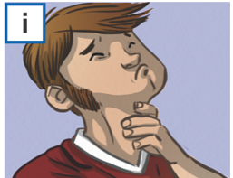
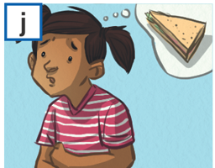
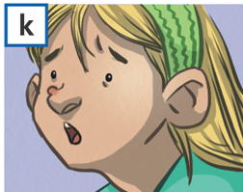
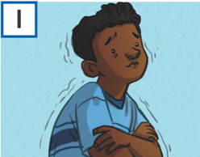
g) She’s got a cold.
h) His ear hurts.
i) He’s got a sore throat.
j) She’s hungry.
k) She’s got a spot.
l) He’s cold.

Slide 5
Write the words and translate them.
............. /ˈpeɪnˌkɪlər/
............. /ˈprɒpəli/
............ /ɡiːk/
............ /niːt/
............ /ˈwaɪtbɔːd/
............ /ˈθɜːsti/
............ /ˈtuːθeɪk/
.......... /ˌsɔː ˈθrəʊt/
.......... /spɒt/

