Slide 1
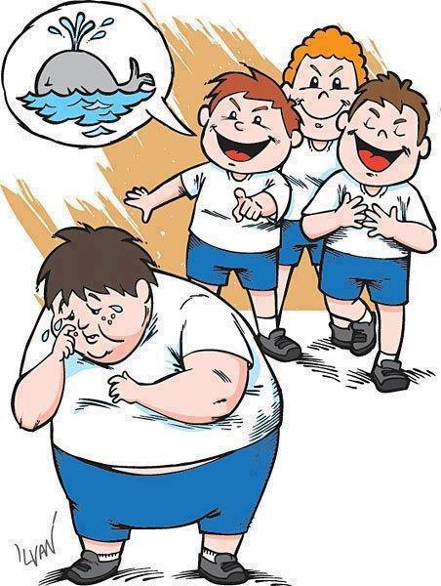

Slide 2
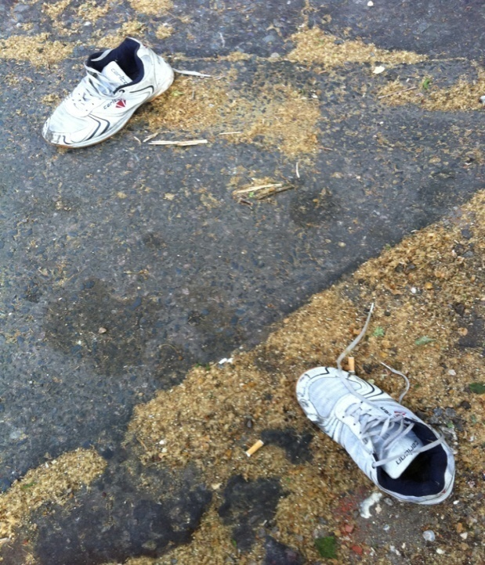

Slide 3
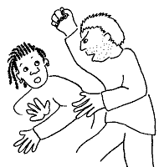

Slide 6
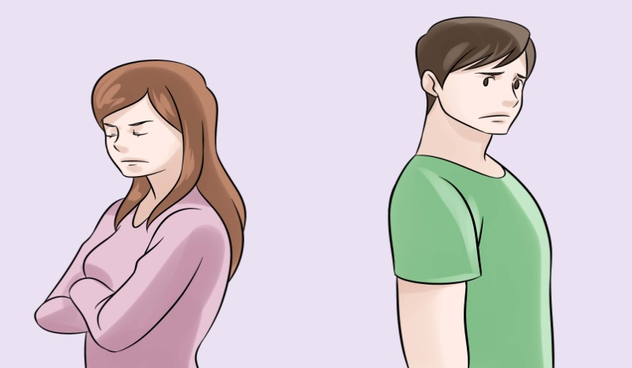
. . .

Slide 7
a h – a line of bushes
Exp– force someone to leave school, country, . . .
Re – communicate with someone in a different place
ign – give no attention to sth/sbd
car – continue doing something

