Slide 1
What are houses made of?

Slide 2
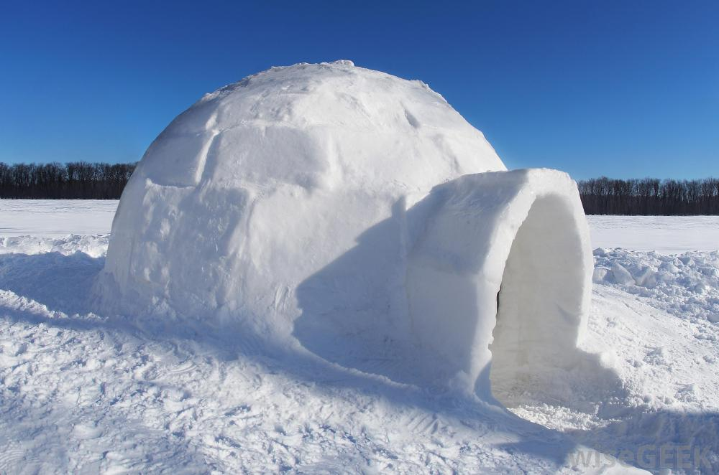
An igloo
An igloo is made of snow.

Slide 3
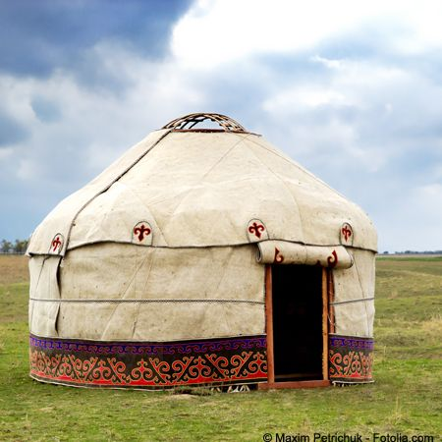
A yurt
A yurt is made of animal skin and wood.

Slide 4
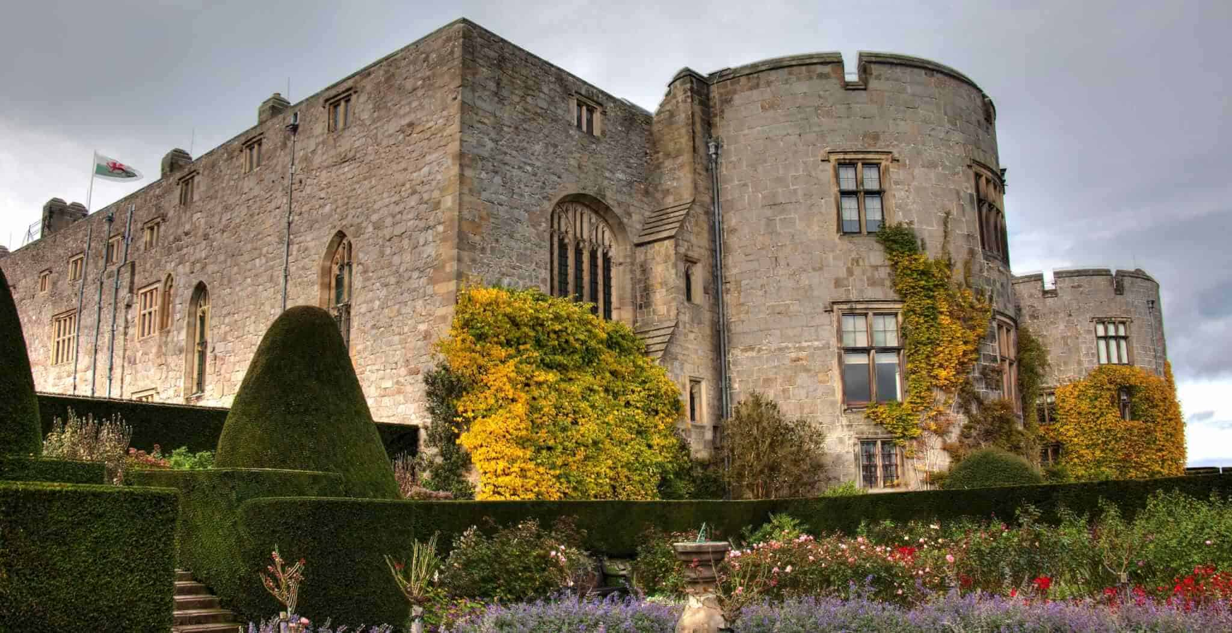
A castle
A castle is made of stone.

Slide 5
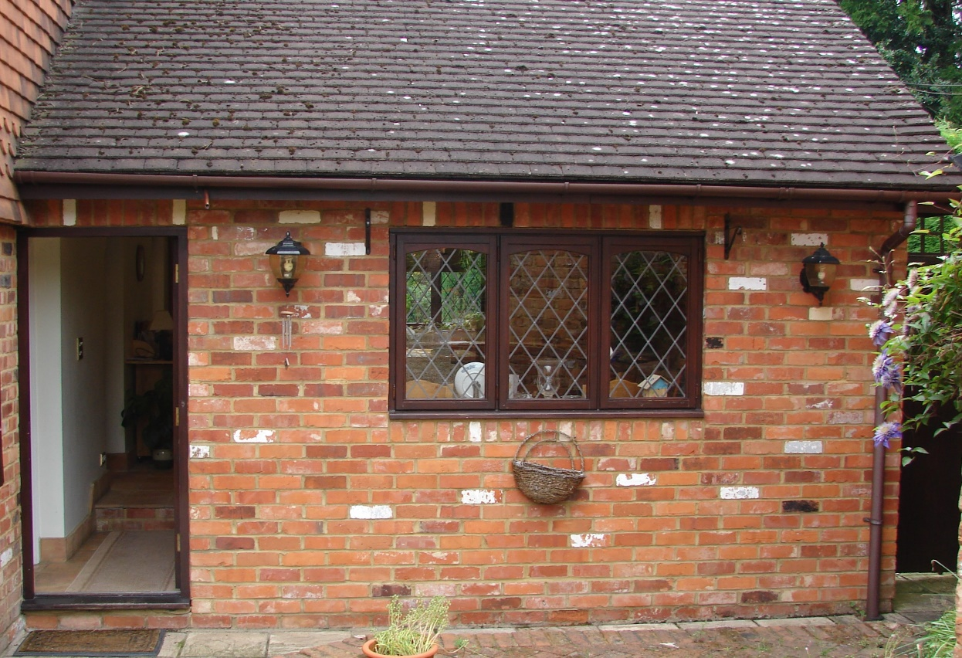
A house
This house is made of bricks.

Slide 6
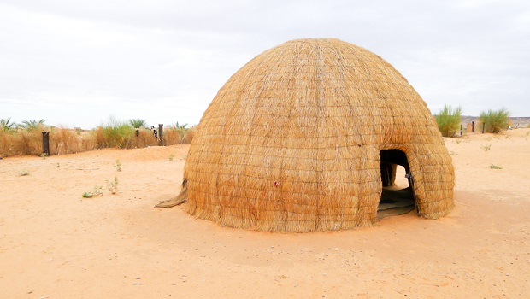
A house
This house is made of straw.

Slide 7
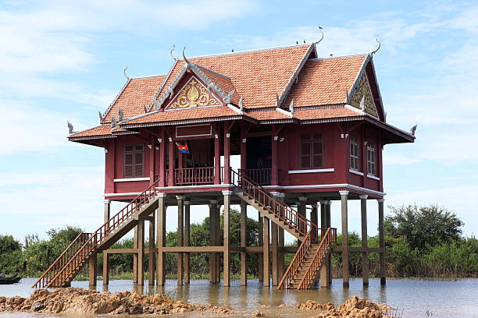
A stilt house
A stilt house is made of wood and metal.

