Slide 1
A SURPRISE
IZNENAĐENJE

Slide 2
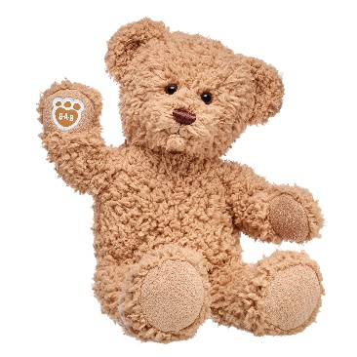
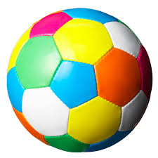
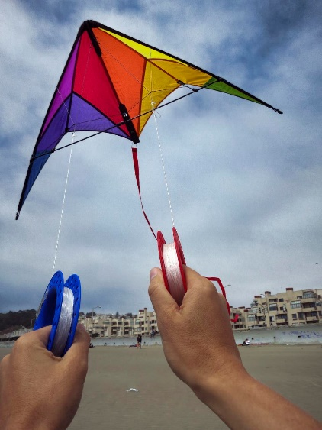
NEW WORDS (NOVE RIJEČI)
A TEDDY
A BALL
A KITE

Slide 3
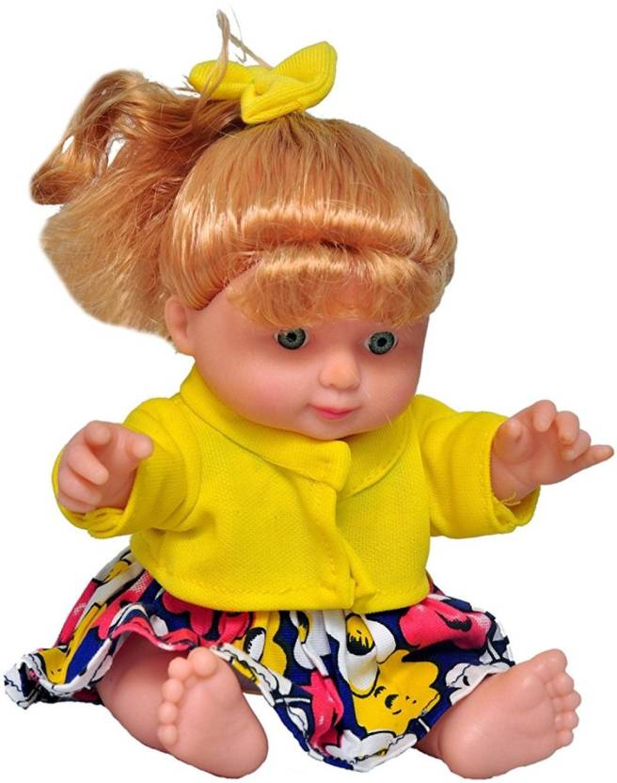
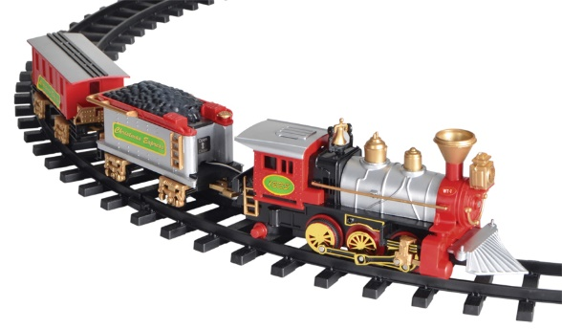
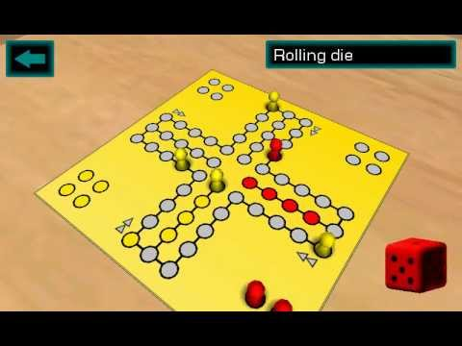
A TRAIN
A DOLL
A GAME

Slide 4
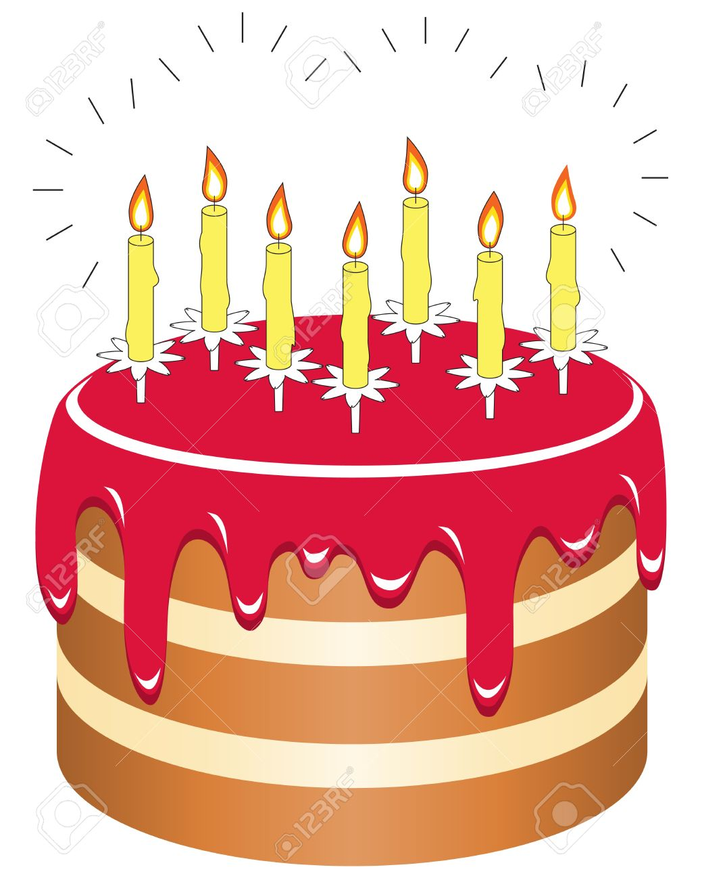
HOW OLD ARE YOU? (KOLIKO IMAŠ GODINA?)
I AM SIX.
I AM SEVEN.
I AM EIGHT.
I AM SIX AND A HALF.
I AM SEVEN AND A HALF.
I AM EIGHT AND A HALF.

