Slide 1
Wild animals

Slide 2
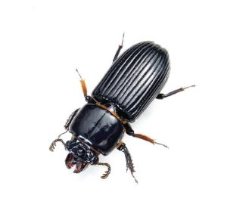
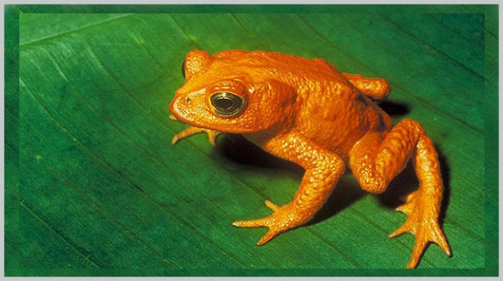
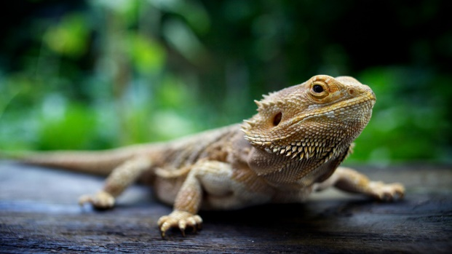
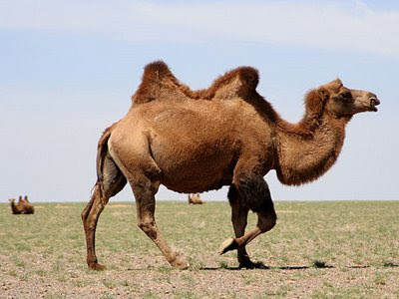
an insect an amphibian a reptile a mammal
INSECTS | AMPHIBIANS (vodozemci) | REPITLES (gmazovi) | MAMMALS (sisavci)
They have three body parts and six legs; some insects have got wings. | They spend a part of their life in water and a part on land. | They are cold-blooded animals with scaly skin and they lay eggs. cold-blooded – hladnokrvan scaly – prekriven ljuskama lay eggs – nesti jaja | They are warm-blooded animals, usually with hair, and they feed their babies with milk. hair - krzno

Slide 3
Book, page 96, exercise 1
Workbook, page 48, exercises 1, 2 and 3.

Slide 4
Describe an animal of your choice. First, draw a table and fill it in.
An example: An elephant
HABITAT | DIET | LIFE SPAN | MAIN CHARACTERISTIC | EXPLAIN YOUR CHOICE
-in Africa and Asia | -herbivorous (they eat plants) | -up to 70 years | -a mammal -”gentle giants” -three types -the biggest land animal -the biggest elephant ever was 4 m tall -thick skin, tusks (made of ivory), a trunk (2 m long) | -intelligent -non-aggressive -endangered -people kill lots of elephants every year -ivory (tusks) -jewellery

Slide 5
Self-assessment (Ocjeni se.)
Govorenje – opis životinje po vlastitom izboru
Govorim tečno i pravilno izgovaram riječi
Koristim primjereni vokabular: animals, habitat, diet, main characteristic …adjectives: big, strong, smart, aggressive, endangered, dangerous …
Pravilno koristim Present Simple: I/you/we/they go; he/she/it goes; don't go/doesn't go; there is/are

