Slide 1
Meet the bloggers

Slide 2
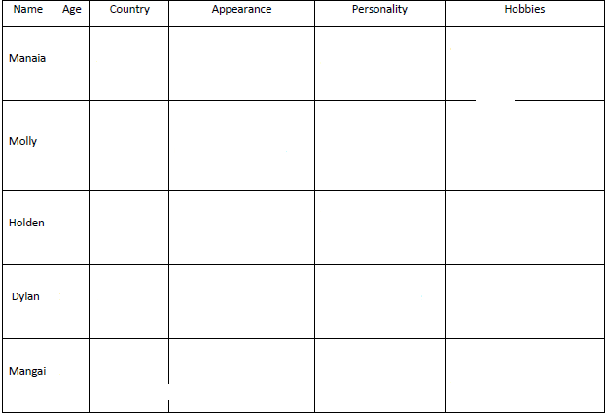

Slide 3
Try to guess the answers.
How old is he/she?
Where is he/she from?
What does he/she look like?
What is he/she like?
What hobbies has he/she got?
Molly | Manaia | Holden | Dylan | Mangai

Slide 4
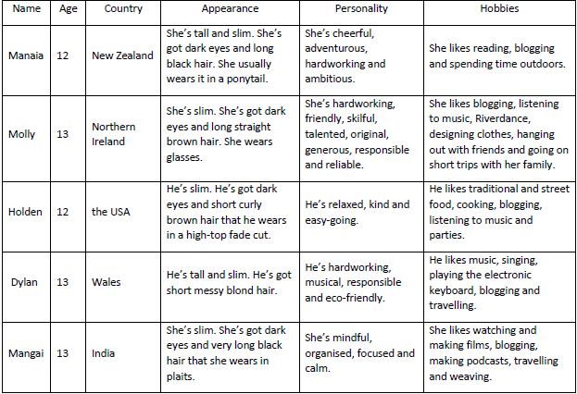
Check your answers

Slide 5
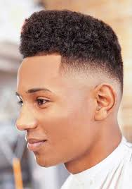
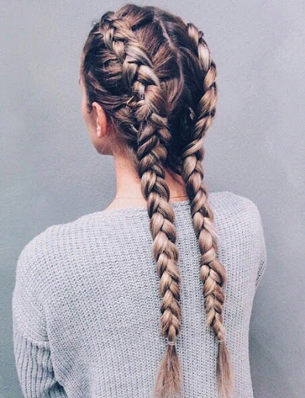
Vocabulary
cheerful, adj. /ˈtʃɪəfʊ/ veseo
skilful, adj. /ˈskɪlfʊl/ vješt
generous, adj. /ˈdʒɛn(ə)rəs/ darežljiv
reliable, adj. /rɪˈlʌɪəb(ə)l/ pouzdan
mindful, adj. /ˈmʌɪn(d)fʊl/ promišljen
podcast (noun) /ˈpɒdkɑːst/ datoteka s audio ili audio-video zapisom koja se dijeli putem interneta
weave (verb) /wi:v/ tkati
high-top fade cut (hair)
plaits

