Slide 1
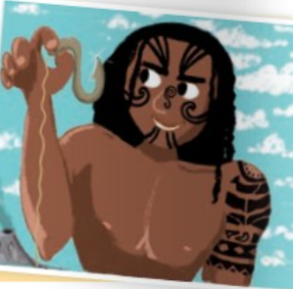
Maui’s fish
Fishing up an island

Slide 2
Paragraph 1
1 Who did Maui go fishing with?
2 How did he do it?
3 What is a fishhook?
4 What can you say instead of „Fish, beware”?
1 He went with his brothers.
2 He tricked them and hid under the floorboard of their canoe.
3 It is a hook used for catching fish.
4 You can say „Fish, watch out”.

Slide 3
Paragraph 2
1 Where are you when you are out of sight?
2 Why are Maui’s clothes all wet and rumpled?
3 What can you say instead of ‘his eyes are gleaming’?
4 What can you say instead of ‘rumbled clothes’?
1 You are far away and you are invisible.
2 Because he was hiding under the floorboard of the canoe.
3 ‘His eyes are shining’
4 ‘Creased clothes’.

Slide 4
Paragraph 3
1 How did Maui catch the fish?
2 What is ‘surface’?
3 What did Maui’s brothers do with the fish then?
4 What does ‘furious’ mean?
1 He caught it with the help of his magical fishhook.
2 The outside part of something.
3 They cut the fish.
4 It means very angry.

Slide 5
Paragraph 4
1 What happened when Maui’s brothers started cutting the fish?
2 Why is the island called Maui’s fish?
3 What is ‘a valley’?
4 What is ‘a coast’?
1 The fish transformed into an island.
2 Because Maui fished it up with a magical fishhook.
3 A low area of land.
4 A part of land which is near the sea.

Slide 6
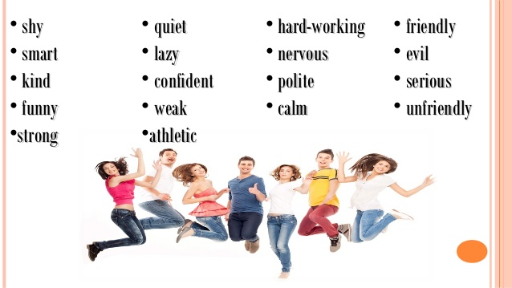
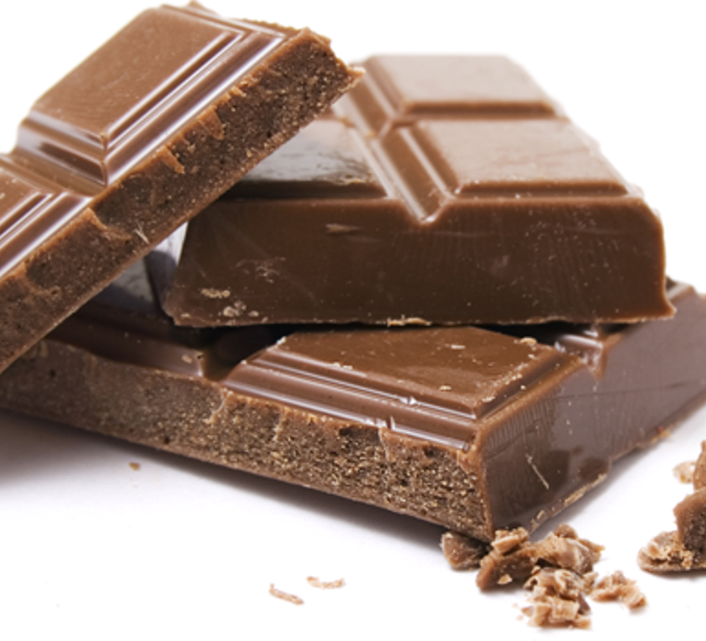
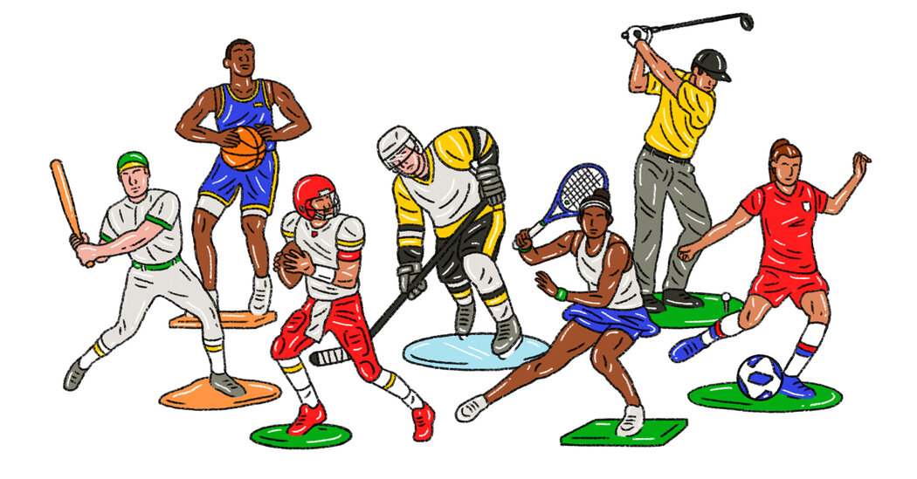
Describing appearance, personality and interests.
What does she look like?
What does she like?
What is she like?

Slide 7
Let’s describe Maui. Make notes. What did Maui look like?
Age
Build
Face
Hair
probably 13 years old
small and quite slim
round
long, black, straight
Maui was 13 years old and he was small and quite slim. His eyes were big and dark and his face was round. He had long, black, straight hair.

Slide 8
What was Maui like?
(Choose 2/3 adjectives and explain why you think so.)
adventurous,
brave/courageous
persistent/stubborn
respectful/grateful
Maui was adventurous and brave because he was not afraid of taking risks. He was also persistent so he didn't give up easily. He respected the god of the sea and he was grateful to him for protecting and helping his people.
What did Maui like?
(What were his hobbies and interests? Give 3 or 4 ideas.)
fishing
making tools
travelling/exploring
He was good at fishing and he liked it more than anything else. He was also good at making tools so he made a magical fishhook. He caught a huge fish with it. He probably liked travelling and exploring because he was brave and adventurous.

Slide 9
Describe yourself.
What do you look like?
age
build
height
face
hair
eyes
nose
lips
What are you like?
friendly, out-going, shy, honest, generous, a bit lazy, hard-working, curious, ambitious, sporty, cheerful, helpful, …
What do you like?
playing sports, listening to music, watching films, reading books, doing household chores, hanging out with my friends …

