Slide 1
Family tree

Slide 2
Copy the family words you want to learn better.
Mother, father, husband, wife, parents, brother, sister, son, daughter, child, children, grandmother, grandfather, grandparents, granddaughter, grandson, grandchildren, uncle, aunt, cousin,
niece – nećakinja
nephew - nećak

Slide 3
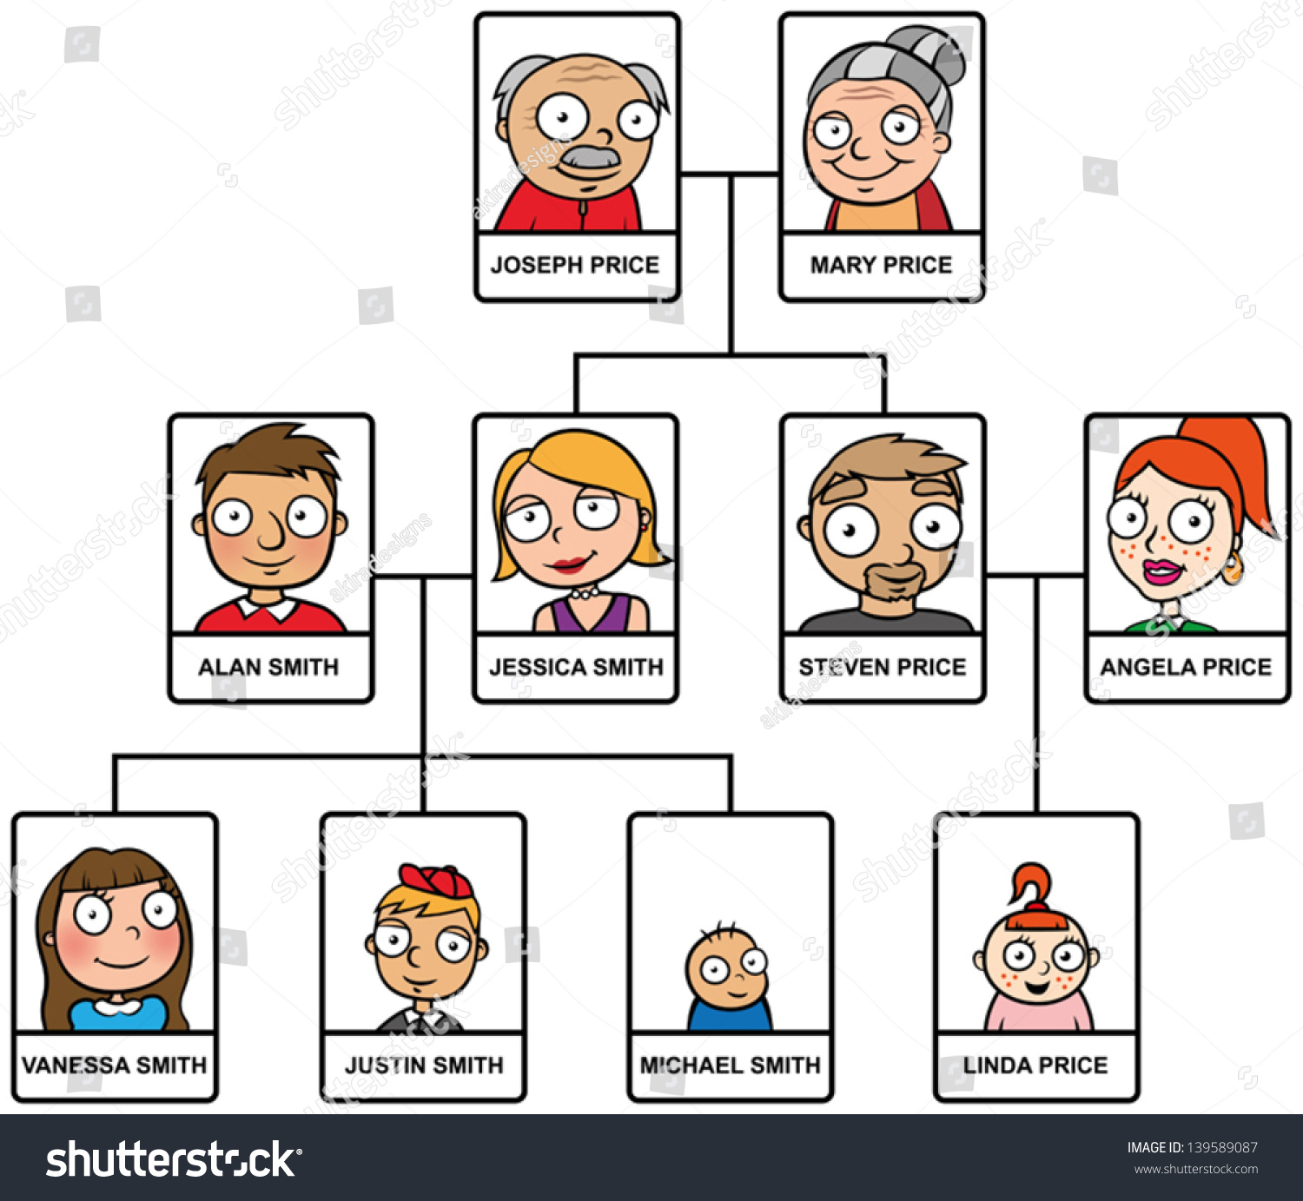

Slide 4
Use possessive adjectives: my, your, his, her, its, our, their
Their
1 These are Aiko and Hitoshi. _____ daughter is Yoko.
2 Kiko says: Stephan is ____ husband.
3 I ask Tatsuo: Is _____ wife Japanese? No, she’s from Austria.
4 Kiko and Stephen say: Aiko is ________ daughter.
5 Antoine is French. _______ wife is Tamiko.
6 Yoko is wearing a T-shirt. _____ colour is white.
7 Look at Tamiko. ________ hair is grey.
8 Anya and Tatsuo say: _______children are Hitoshi and Tamiko.
9 Yoko asks me: Is _______ family big or small?
10 Look at Kiko and ______ smile.
my
your
our
His
Its
Her
Our
your
her

Slide 5
Possessive genitive
George is Julia’s brother.
Their grandparents’ names are Elizabeth and Arthur.
They are Elizabeth and Arthur’s grandchildren.
together
The children’s names are Noah and Rose.
1 person
more than 1 person

