Slide 1
Present Perfect questions and short answers
HAVE, HAS + Past Participle

Slide 2
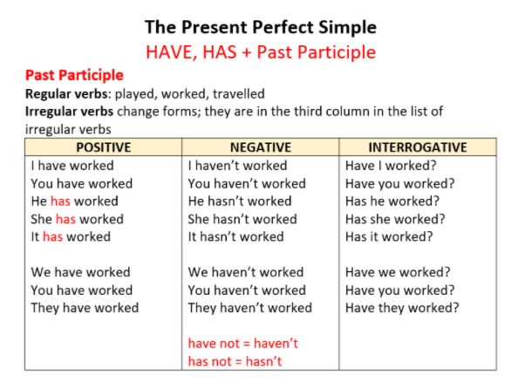

Slide 3
Yes-no questions Short answers:
Maria has taken a tablet for her headache.
Has Maria taken a tablet for her headache?
They have played games for 4 hours non-stop.
Have they played games for 4 hours non-stop?
Yes, …
Yes, she has.
No, …
No, she hasn’t.
Yes, …
Yes, they have.
No, …
No, they haven’t.

Slide 4
Gaming has helped Ivan with his English.
Has gaming helped Ivan with his English?
My friends have experienced health problems related to technology.
Have your friends experienced health problems related to technology?
Yes, ...
Yes, it has.
No, …
No, they haven’t.

Slide 5
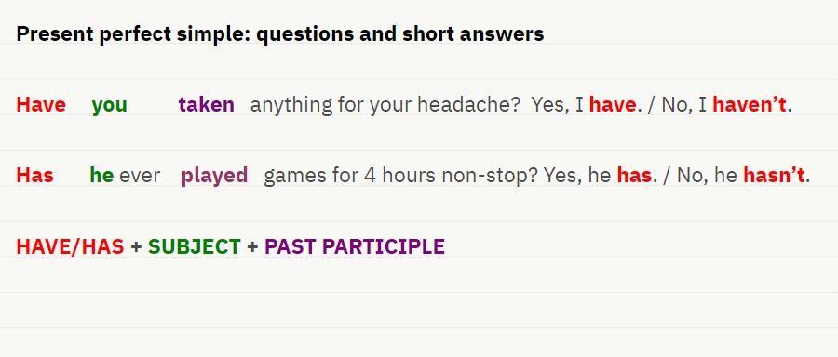

Slide 6
Make questions and complete the short answers
… Maria (be) to Ireland?
Yes, …
2) … your (read) The Lord of the Rings?
No, …
3) … your mum (work) for that company?
No, …
4) … they (set) a new record in this game?
Yes, …
5) … you (played) that game?
No, …
Has Maria been to Ireland?
Yes, she has.
2) Have your read the Lord of the Rings?
No, I haven’t.
3) Has your mum worked for that company?
No, she hasn’t.
4) Have they set a new record in this game?
Yes, they have.
5) Have you played that game?
No, I haven’t.

