Slide 1
Louisiana
New Orleans

Slide 2
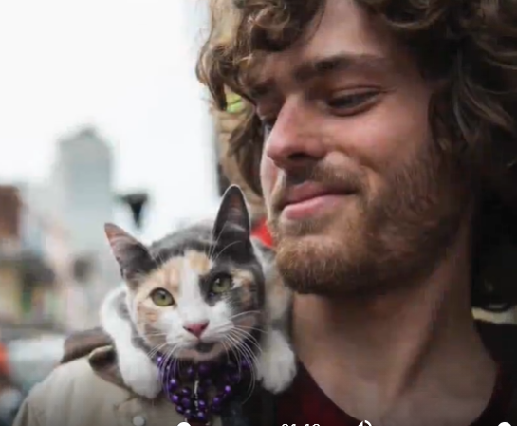
Vocabulary
The Cajuns
people who live in Louisiana and whose relations in the past were French-speaking Canadians

Slide 3
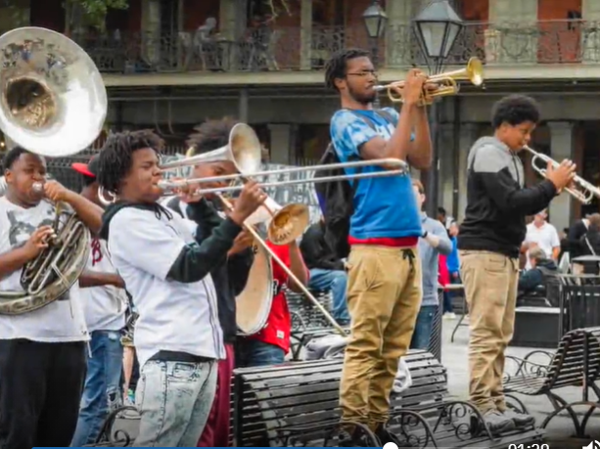
The Creoles
people of mixed African American, French and Indian American origin.

Slide 4
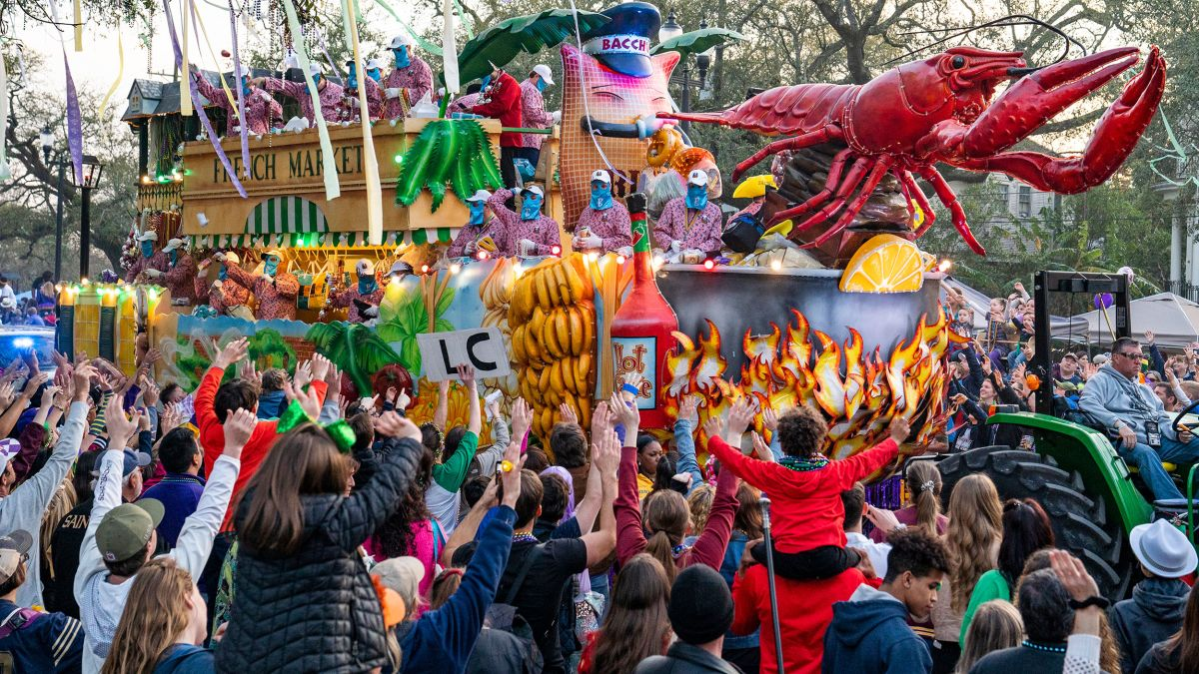
Mardi Gras
the day before the beginning of Lent, celebrated in some countries with a lot of music, colourful costumes and dancing in the streets

Slide 5
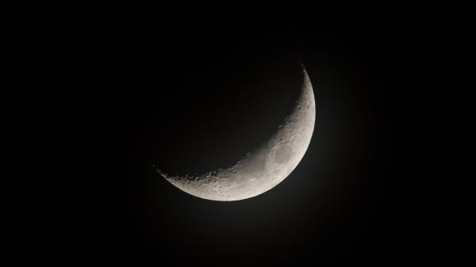
crescent (noun)
a curved shape (like the moon when it is less than half of a circle)

