Slide 1
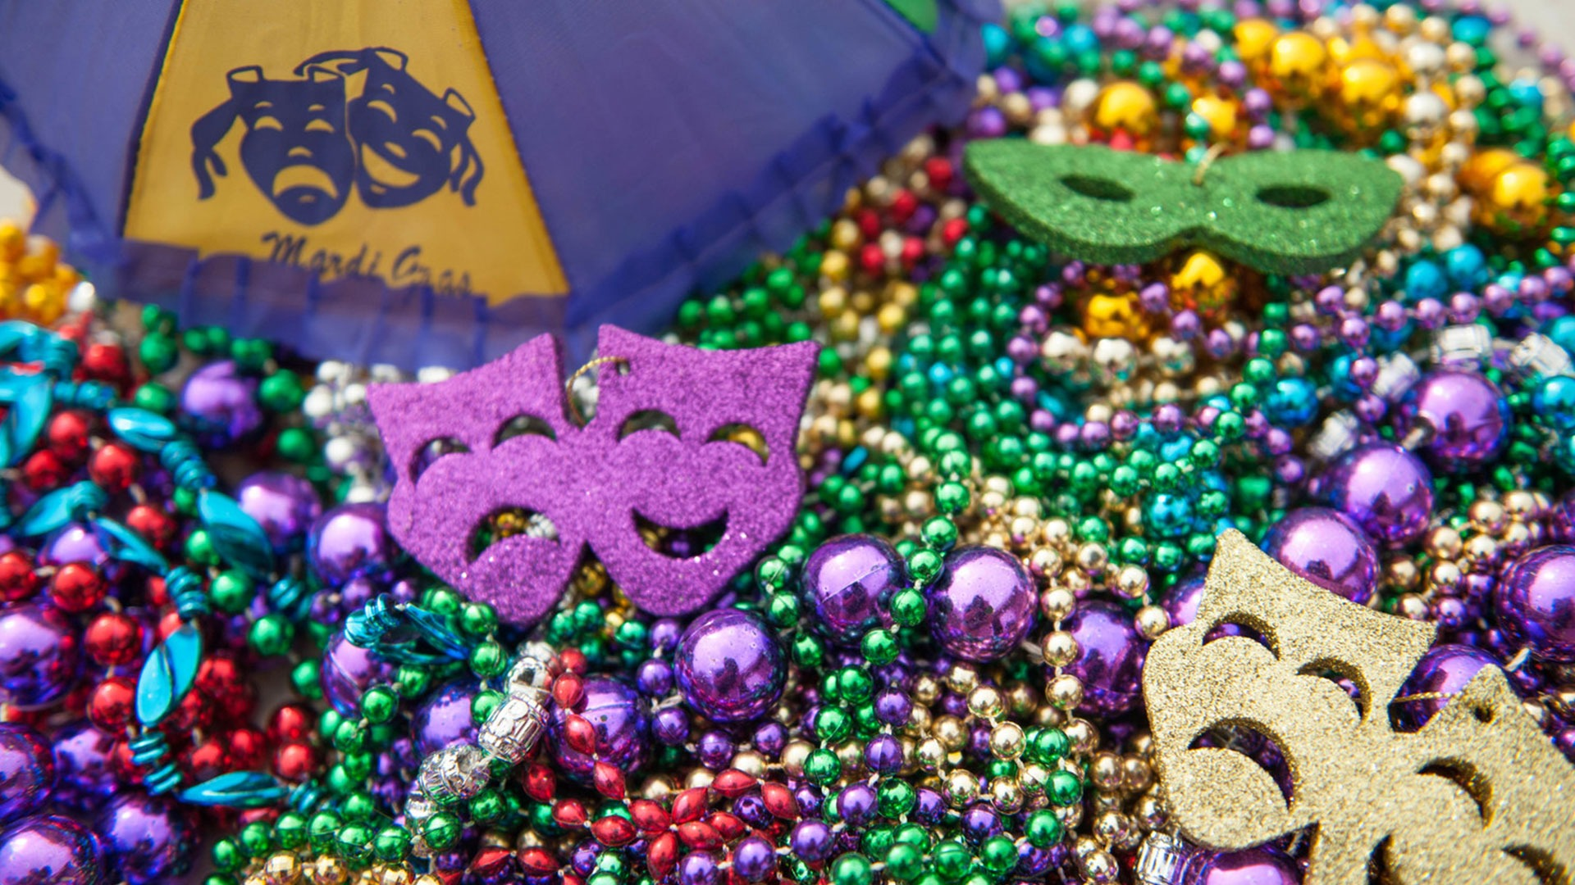
Mardi Gras

Slide 2
1 What is Mardi Gras?
2 When does it take place?
3 What is Lent?
4 What can you do during the Mardi Gras festival?
5 How much is the entrance fee for the festival?
6 What is the motto of New Orleans and what does it mean?
Mardi Gras is the holiday before Lent and the end of a two-week festival season.
It takes place on Fat Tuesday, which is the last day before Lent.
Lent is a 40-day period before Easter which is devoted to fasting.
You can see parades, concerts, balls and shows. You can also enjoy fantastic local food.
The Mardi Gras festival is free.
The motto is ‘Let the good times roll’ and it means Have a great time!

