Slide 1
MUCH, MANY SOME, ANY A FEW, A LITTLE

Slide 2
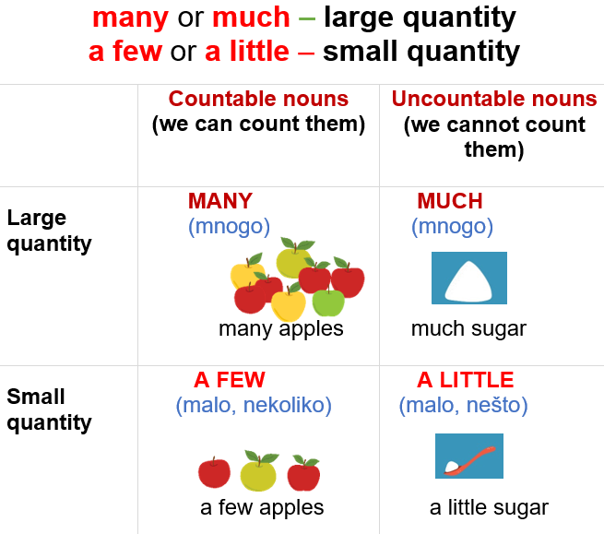

Slide 3
Countable nouns | Both | Uncountable nouns
many (-) How many? few / a few | some (+) any (-, ?) a lot of / lots of | much (-) How much? little / a little

Slide 4
Use: a few, a little, much or many.
1 I’ve got … petrol. We need to stop and get some.(malo)
2 There was … food in the fridge. Only a few pieces of fruit. (malo)
3 You travel a lot. Have you been to … countries? (mnogo)
4 There are … things I haven’t told you; I always tell you everything. (nekoliko)
5 We spent too … money on last holiday. (mnogo)
6 Did … people come to your party? (mnogo)
7 They don’t usually drink … beer. (mnogo)
8 I only speak … Spanish. (malo)
9 I need … sugar for the cake. (malo)
10 There were only … people on the beach because it was raining. (nekoliko)
11 There aren’t … people in the streets. (nema mnogo)
1 a little
2 a little
3 many
4 a few
5 much
6 many
7 much
8 a little
9 a little
10 a few
11 many

Slide 5
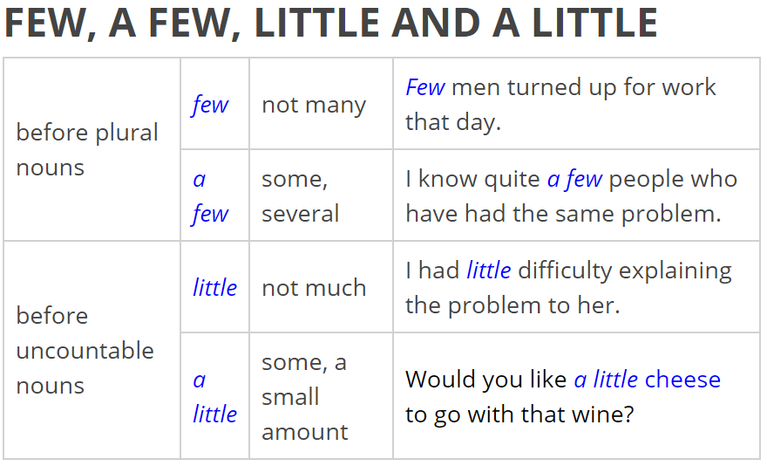
What is the difference between: few – a few and little – a little?
Few – not enough
A few – some, several
Little – not enough
A little – a small amount

Slide 6
Choose: few, a few, little or a little.
1 Let’s go to the cinema. I’ve got … money.
2 Sorry. I can’t pay for your lunch. I have … money.
3 Not many children like vegetable. For instance, only … eat spinach.
4 John is always angry. That’s why he has … friends
5 The party was fun. There were … people I knew there.
6 Your house is almost empty. You have … furniture.
7 Greg is always busy. He has … free time.
8 I need to talk to you. Do you have … minutes?
9 Rodney feels that his life is very dull. He has … adventures.
10 Let’s get together when we have … free time.
1 a little
2 little
3 few
4 few
5 a few
6 little
7 little
8 a few
9 few
10 a little

Slide 7
How many?
countable nouns
How many sandwiches do you usually take on a journey?
I usually take three sandwiches.
How many messages do you send?
I send more than ten messages.
How much? uncountable nouns
How much stuff do you take on a journey?
I take too much stuff.
How much luggage do you take?
I take just one bag.
How much money do you take?
I don’t take much money.

Slide 8
Use “How much” or “How many”.
…...bread do you eat?
…..brothers and sisters do you have?
…..sugar do you put in your coffee?
….postcards do you have to buy?
….luggage have you got?
….money have you got?
….free time do you usually have?
….furniture have you got in your bedroom?
….milk do you drink?
….sandwiches shall I get you?
How much
How many
How much
How many
How much
How much
How much
How much
How much
How many

Slide 9
When do we use
SOME and ANY?

Slide 10
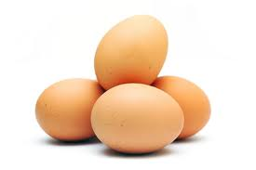
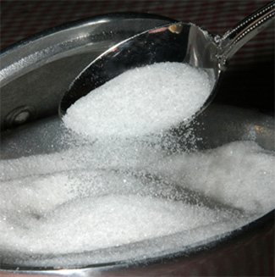
We use SOME in positive sentences.
There are some eggs in the fridge.
There is some sugar in the cupboard.
“eggs” is a countable noun
“sugar” is an uncountable noun

Slide 11
We use ANY in negative sentences and questions.
NEGATIVE SENTENCES:
There aren’t any eggs in the fridge.
There isn’t any salt in the soup.
QUESTIONS
Are there any eggs in this cake?
Is there any sugar in the coffee?

Slide 12
Insert: some or any.
I finished the work without any help.
I was tired, so I went to bed without any supper.
I am going to buy some fruit and vegetables.
In August we had some rain.
She never does any work in the garden.
You’re hungry. I’ll make you some supper.
A: How many children has he got?
B: He hasn’t got any children.
Are there any restaurants near here?
I have some problems with my car.
We need some more milk.
Do you know any Americans?
I’d like some tea, please,
Do you speak any foreign languages?
I didn’t get any sleep last night.

