Slide 1
Unit 3 - revision

Slide 2
Countable nouns | Both | Uncountable nouns
many (-) How many? few / a few | some (+) any (-, ?) a lot of / lots of | much (-) How much? little / a little

Slide 3
Quantifiers
Answer the questions.
Choose the right option.
Choose the right option.
Choose the correct option.
Choose the correct option.

Slide 4
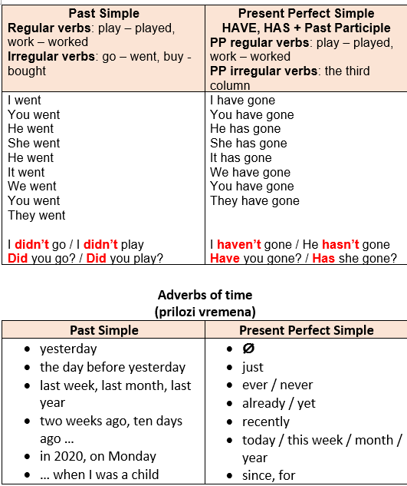
Past Simple and Present Perfect Simple

Slide 5
Use Past Simple or Present Perfect Simple
1 I …my keys, so I can't open that door. ( lose)
2 Columbus … in the New World in 1492. ( arrive)
3 Poppy … her leg. She is still in hospital. (break)
4 I … here for five years. (live)
5 Colin … for Brazil yesterday. (leave)
6 Last winter Robin … with his father in the Alps for three days. (stay)
7 Ellen … chocolate. (never/like)
8 She … a language course in Paris last summer. (do)
9 …anyone … yet? (to phone)
10 I …. Paul today, but I … him last Sunday. (not/to see - to see)
11 She … anything since breakfast. (not eat)
12 Molly … in Londonderry for two weeks. (be)
1 have lost
2 arrived
3 has broken
4 have lived
5 left
6 stayed
7 has never liked
8 did
9 Has anyone phoned
10 haven’t seen / saw
11 hasn’t eaten
12 has been

Slide 6
Change the sentences from direct to indirect speech.
1 She says, “I think my house in New Orleans is really nice.”
2 Ellie says, “The cuisine of my country is very interesting.”
3 Peter says, “You could try working out with my best friend.”
4 Jack says, “I haven’t realized before that people in New Orleans are so friendly.”
5 Miss Jane says, “I would love to travel to New Orleans.”
6 Holden says, “You should listen to some jazz.”
1 She says (that) she thinks her house in New Orleans is really nice.
2 Ellie says that the cuisine of her country is very interesting.
3 Peter says that I could try working out with his best friend.
4 Jack says that he hasn’t realized before that people in New Orleans are so friendly.
5 Miss Jane says that she would love to travel to New Orleans.
6 Holden says that I should listen to some jazz.

